Slide 1
Global Medical Affairs Cover Sheet
Asset Name | <Generic Name: Title> | Respiratory: Clinical Implications of OCS Use and Features of Severe Eosinophilic Asthma
Intended Use | <Reactive or Internal use> | Proactive
Approved for Distribution |  | No |  |  |  | Therapy Area | Respiratory
Asset Owner | Bhavini Parikh/William Cook |  |  |  |  | New or Updated | Updated
Document Number | ML-4006-ALL-0049 |  |  |  |  | Based on Asset (include Vault MedComms or PromoMats document number or N/A for not applicable) | Z4-8971
Approved Date | 11/18 |  | Expiration Date |  | 11/19
Technical Review/Fact Check Completed by Global Medical Information (Yes/No) |  |  |  | Yes |  | Applicable Copyright Permissions Obtained for Graphics (Yes/No) | Yes
This material is globally approved for use by AstraZeneca Medical Affairs Scientific Personnel only. The local market is responsible for interpreting, reviewing, and approving the content according to their local label, rules, and regulations.
Additional Disclaimers or Special Instructions: AstraZeneca does not, under any circumstances, promote its products for off-label or unapproved uses. Do not distribute or share without prior local approval
External use of any of the content must be approved for release by your local nominated signatory/local medical process to ensure compliance with local regulations.
Refer to the General Properties for this asset in GMIP Content (Veeva Vault MedComms) for additional details.
Questions on this asset should be directed to asset owner.

Slide 2
Clinical Implications of Oral Corticosteroid Use in Severe Asthma and Features of Severe Eosinophilic Asthma Role of T2 Inflammation
Update on the Management of Severe Asthma
10/18
10/19

Slide 3
Clinical Implications of OCS Use in Severe Asthma
Place in Therapy
OCS Morbidities
OCS Burden of Disease
OCS Economic Burden

Slide 4
Objectives
Review the role of OCS in severe asthma and the related burden of OCS in terms of adverse outcomes and healthcare costs
Explain the difference between T2-high and T2-low asthma phenotypes and describe the role of IL-4, IL-5, and IL-13 driving eosinophilic inflammation
Describe and discuss clinical features commonly associated with eosinophilic asthma

Slide 5
Anti-IL5 and IL-5Rα Treatment Continues to be Included as Step 5 Treatment in GINA 2018
GINA
Step 5
Refer for add-on treatment (eg, tiotropium,^{a,d} anti-IgE,
anti-IL5)ª
Step 4
Med/High ICS/LABA
Preferred
controller
choice
Step 1
Step 2
Low-dose ICS
Step 3
Low-dose ICS/LABA^{b}
Add tiotropium^{a,d}
Med/High ICS + LTRA (or +theophylline)ª
Med/High ICS
Low-dose ICS + LTRA (or + theophylline)ª
Other
options
Consider
low-dose ICS
LTRA
Low-dose theophyllineª
Add
low-dose OCS
As needed: SABA
As needed: SABA or low-dose ICS/formoterol^{c}
Reliever
Step 5 add-on treatment options include:
anti-interleukin-5 receptor or anti-interleukin 5 treatment with severe eosinophilic asthma that is uncontrolled on Step 4 treatment
ªNot for children <12 years. ^{b}For children 6-11 years, the preferred Step 3 treatment is medium-dose ICS. ^{c}Low-dose ICS/formoterol is the reliever medication for patients prescribed low-dose budesonide/formoterol or low-dose beclomethasone/formoterol maintenance and reliever therapy. ^{d}Tiotropium by mist inhaler is an add-on treatment for patients with a history of exacerbations; it is not indicated in children <12 years.
GINA = Global Initiative for Asthma; ICS = inhaled corticosteroids; IgE = immunoglobulin E; IL5 = interleukin-5; LABA = long-acting β agonists; LTRA = leukotriene receptor agonist; OCS = oral corticosteroids; SABA = short-acting β agonists.
Global Initiative for Asthma (GINA) 2018. http://www.ginasthma.org. Accessed September 11, 2018.
Notes:
Note:
Benralizumab has been added to GINA 2018 Step 5 treatment.
Background: The GINA guidelines group together the IL-5 and IL-5R agents in the diagram but calls them out as different modalities in the full text. It is important to emphasize benralizumab’s mechanism of action of enhanced antibody-dependent cell-mediated cytotoxicity discussed in the next slides
Reference:
Global Initiative For Asthma (GINA). Global strategy for asthma management and prevention. Updated 2018. http://ginasthma.org/2018-gina-report-global-strategy-for-asthma-management-and-prevention//. Accessed September 11, 2018.

Slide 6
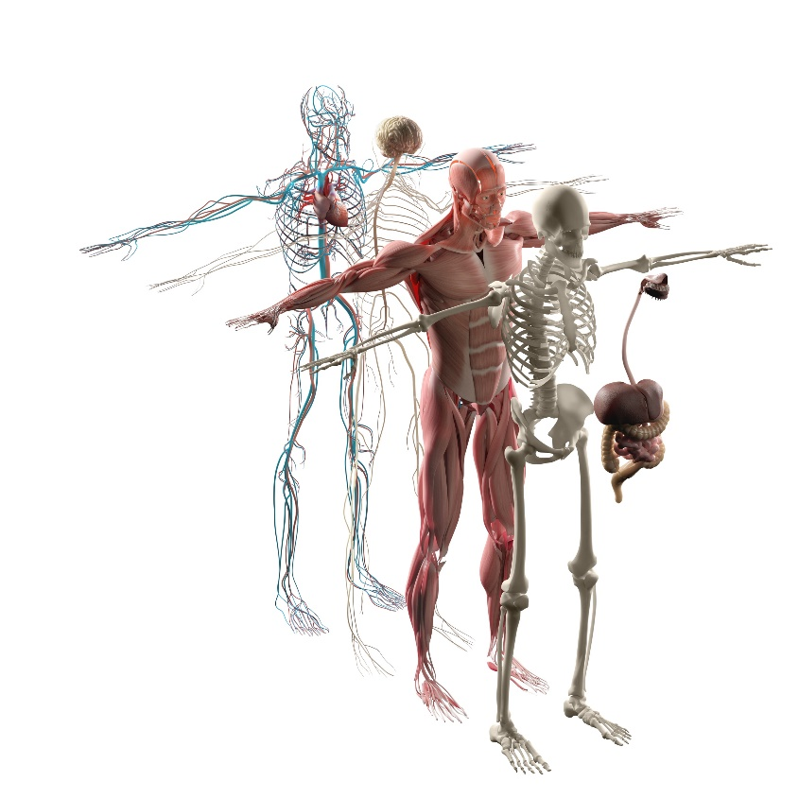
OCS-Related Adverse Events Are Common and Affect Multiple Organs in Patients With Asthma
OCS
Burden
Odds of OCS-Related Morbidity (Severe vs. Mild/Moderate Asthma; n=4783)
Real World Evidence from OPCRD
Hypertension
OR, 1.35; p=0.001 (34% vs. 29%)
Psychiatric disorders
OR, 1.43; p<0.001 (38% vs. 31%)
Cardiovascular disease
OR, 1.36; p=0.035 (10% vs. 7%)
Cataracts
OR, 1.89; p<0.001 (9% vs. 5%)
Metabolic disorders:
Type II diabetes OR, 1.46; p=0.006 (10% vs. 7%)
BMI >30 kg/m² OR, 1.36; p<0.001 (42% vs. 35%)
Dyspeptic disorders
OR, 3.99; p<0.001 (65% vs. 34%)
Osteoporosis
OR, 5.23; p<0.001 (16% vs. 4%)
Cross-sectional observational study of patients with severe (required GINA Step 5 treatment and ≥4 OCS prescriptions/year in 2 consecutive study years) and mild or moderate (GINA Step 2-3) asthma.
Results are based on data from the OPCRD, a UK respiratory database (N=7195)
Note: Similar rates observed as OPCR database, in addition to high rates of osteopenia (35%) and obstructive sleep apnea (11%).
BMI = body mass index; OPCRD = Optimum Patient Care Research Database; OR = odds ratio.
Sweeney J et al. Thorax. 2016;71:339-346.
Notes:
Note:
Present slide.
Reference:
Sweeney J, Patterson CC, Menzies-Gow A, et al. Comorbidity in severe asthma requiring systemic corticosteroid therapy: cross-sectional data from the Optimum Patient Care Research Database and the British Thoracic Difficult Asthma Registry. Thorax. 2016;71:339-346.

Slide 7
Increased Risk of Complications Over ~7 Years Associated With Increased Daily Steroid Exposureª
OCS Dose & Exposure
Less likely to have complication
More likely to have complication
Hazard ratios [95% CI]
SCS dose ≥10 mg/day
Renal Impairment
1.85 [1.55 ; 2.21] 1.34 [1.14 ; 1.57]
1.23 [1.07 ; 1.42]
T2 DM
2.59 [2.07 ; 3.24] 2.03 [1.65 ; 2.50]
1.34 [1.11 ; 1.63]
SCS dose 5-<10 mg/day
Pneumonia
3.98 [3.09 ; 5.14] 3.36 [2.65 ; 4.26]
2.52 [2.02 ; 3.14]
SCS dose 2.5-<5 mg/day
Hypertension
1.00 [0.77 ; 1.30]^{b} 0.91 [0.71 ; 1.16]^{b}
1.02 [0.84 ; 1.23]^{b}
Osteoporosis
8.23 [6.20 ;10.91] 4.65 [3.52 ; 6.14]
3.65 [2.84 ; 4.70]
Glaucoma
1.99 [1.30 ; 3.05] 1.37 [0.89 ; 2.10]^{b}
1.35 [0.94 ; 1.93]^{b}
Statistical significance at a p-value of<0.01; all outcomes except HTN and gluacoma^{b}
Peptic Ulcer
2.68 [1.41 ; 5.10] 2.10 [1.14 ; 3.85]
2.12 [1.26 ; 3.57]
Cataract
2.92 [2.36 ; 3.62] 1.96 [1.60 ; 2.41]
1.73 [1.44 ; 2.07]
0.7
0.9
1
1.5
2
2.5
3
4
5
6
7
8
9
10
Hazard Ratios
Note: 98% of SCS prescriptions were for OCS. ªMedian follow-up exposure period of over 7 years.
Price DB et al. Article and supplementary methods. J Asthma Allergy. 2018;11:193-204.
Real world evidence of UK historical matched cohort study of patients with active asthma and
median availability of medical records (1984 to 2017) before SCS use. (n=48,234)
Notes:
Note:
Present slide.
Additional Information:
Historical matched cohort study of patients with asthma aged ≥18 years with ~9 years of median availability of medical records before SCS use and a median of ~7 years of follow-up. Longitudinal medical records analyzed from the OPCRD = Optimum Patient Care Research Database (OPCRD) and Clinical Practice Research Datalink (CPRD) from 1984 through 2017 (n=48,234)
The adjusted risk of each outcome increased by 21% to 70% for every 5 mg increase in average daily exposure. 98% of SCS prescriptions were for OCS.
Abbreviations:
DM = diabetes mellitus; OCS = oral corticosteroid; SCS = systemic corticosteroid; T2 = type 2.
Reference:
Price DB, Trudo F, Voorham J et al. Adverse outcomes from initiation of systemic corticosteroids for asthma: long-term observational study [article and supplementary methods]. J Asthma Allergy. 2018;11:193-204.

Slide 8
Adverse Outcomes Associated With Daily SCS Exposure With Time
OCS
AEs & Exposure
Incidence Rates,ª (%)
Adverse outcomes among patients with an average of three steroid bursts per year
Data from medical records of patients with asthma aged ≥18 years with a minimum of 1 year baseline period and of a minimum of 2 year follow-up period from 1994 to 2015. Results are based on data from CPRD and HES databases (n=9413).
ªSCS patients with 2.5-<5mg/day prednisolone equivalent. Cardio-CVA = cardio-cerebrovascular disease; CPRD = Clinical Practice Research Datalink; CVA = cerebrovascular accident; HES = Hospital Episode Statistics; HF = heart failure; MI = myocardial infarction; T2 DM = type 2 diabetes mellitus; SCS = systemic corticosteroid.
Voorham J et al. Online ahead of print. Supporting information. Allergy. 2018.
Notes:
Notes:
Patients treated with SCS (2.5-<5mg/day prednisolone equivalent), in many cases have more than double the cumulative incidence of adverse outcomes from 5 to 15 years
Risk of developing
Renal impairment 11% to 39%
T2 DM 5% to 16%
Pneumonia 10% to 24%
Reference:
Voorham J, Xu Xiao, Price D, et al. Health care resource utilization and costs associated with incremental systemic corticosteroid exposure in asthma[published online ahead of print]. Supporting information. Allergy. 2018. http://dx.doi.org/10.1111/all.13556 Accessed September 11, 2018.

Slide 9
The Risk Of Developing OCS-Associated AEs Increases With Intermittent OCS Use (≥4 Prescriptions Per Year) In Asthma
OCS Exposure
Real World Evidence of ORs of Specific AEs Associated With Use of ≥4 Prescriptions in the Current Year^{a,b}
Osteoporosis
Hypertension
Obesity
Type 2 diabetes
Cataracts
Gastrointestinal
Fractures
0.900
1.100
1.300
1.500
1.700
Logistic regression controlling for age, sex, geographic region, years since the index date, insurance type, use of immunosuppression medication (yes/no; not OCS), and general comorbidity burden.
Results of retrospective cohort study with an asthma diagnosis^{b} from 2000 to 2014
from data from an insurance claims set (MarketScan) (N=228,436)
Note: Baseline OCS dose not provided. ªA list of AEs associated with OCS was derived from previously published studies in asthma and other conditions. ^{b}Previous exposure to OCS was also associated with increased odds of having a new AE in the current year for osteoporosis, hypertension, obesity, DM, dyslipidemia, and fractures. AE = adverse event; DM = diabetes mellitus; OR = odds ratio; prior = year or years before the year in which the adverse effect occurred; RWE = real world evidence.
Sullivan PW et al. J Allergy Clin Immunol. 2018;141:110-116.
Notes:
Note:
Present slide.
Odds of new AE 1.29 when ≥4 Rx in the current year 1.11 for each prior year with ≥4 Rx.
Each year with ≥4 Rx (current and past) resulted in 1.2X odds of new AE during the current year.
Additional Information:
A list of AEs associated with OCS was derived from previously published studies in asthma and other conditions. Previous exposure to OCS was also associated with increased odds of having a new AE in the current year for osteoporosis, hypertension, obesity, DM, dyslipidemia, and fractures.
Abbreviations:
AE = adverse event; DM = diabetes mellitus; OCS = oral corticosteroids; OR = odds ratio; prior = year or years before the year in which the adverse effect occurred
Reference:
Sullivan PW, Ghushchyan VH, Globe G, et al. Oral corticosteroid exposure and adverse effects in asthmatic patients. J Allergy Clin Immunol. 2018 ;141:110-116.

Slide 10
Asthma Related Healthcare Costs Are More Than Twice as Expensive for Patients on SCS Maintenance Treatment
Burden of OCS Use Budget Impact
Total cost = £402.93
Medication costs
Hospitalization
Accident and ED visits
226.72
Specialist visit
Mean Asthma-Related HRUC (£)
GP visit
Total cost = £166.39
46.86
1.36
106.08
36.64
2.99
0.22
95.24
48.16
10.27
Real world evidence analysis of patients with asthma exposed to treatment with SCS and those who were not.
The mean follow up was ~8 years with a minimum 1 year baseline and 2 year follow-up period from 1994 to 2016 (N=18,826)
Note: the median SCS dose was 10 mg/d prednisolone equivalent.
ED = emergency department; GP = general practice; HRUC = Healthcare Resource Use Associated Costs (2016 pounds sterling); OCS = oral corticosteroids;
SCS = systemic corticosteroid (parental corticosteroid or OCS).
Voorham J et al. Online ahead of print. Allergy. 2018.
Notes:
Note:
Present data.
Patients who received maintenance SCS had total mean costs 2.5 times greater than those for the main asthma study population.
Additional Information:
Study results are based on data from the Clinical Practice Research Datalink (CPRD) and Hospital Episode Statistics (HES)
Patients were not matched for disease severity. Control (non-SCS) patients were matched 1:1 by sex, index date, and HES linkage with those initiating SCS
Patients treated with SCS diagnosed with uncontrolled and severe asthma at baseline were 30.4% and 40.3%, respectively.
In the SCS arm 11.9% of patients had ≥4 SCS refills per year
Definitions
Uncontrolled asthma defined as either poor symptom control (either Asthma Control Questionnaire score >1.5, Asthma Control Test score <20, or “not well control” based on National Asthma Education and Prevention Program or GINA guidelines), frequent severe exacerbations requiring ≥2 bursts of SCS for >3 days in the previous year, serious exacerbation requiring ≥1 hospitalizations, intensive care unit stay, or mechanical ventilation in the previous year, or airflow limitation (prebronchodilator FEV₁ <80% predicted in presence of FEV₁/FVC less than lower limit of normal)
Severe asthma defined as GINA Step 4/5 or uncontrolled asthma
Reference:
Voorham J, Xu X, Price D, et al. Health care resource utilization and costs associated with incremental systemic corticosteroid exposure in asthma [published online ahead of print]. Allergy. 2018. http://dx.doi.org/10.1111/all.13556. Accessed September 3, 2018.

Slide 11
T2 Inflammation and Eosinophilic Phenotypes
T2 Mechanism in Asthma
EOS Phenotype
Biomarkers and Clinical Characteristics

Slide 12
Type 2 Inflammation Characterized by Presence of Eosinophils and IgE
Endotype | Key T2 pathways and selected inflammatory functions relevant to asthma |  | Commonly recognized T2-high phenotypes and their biomarkers
T2 high | IL-5 | EOS maturation, activation, and survival^{1,2} | Eosinophilic asthma Sputum eosinophilia (gold standard)^{6,7} Elevated blood EOS (most accurate biomarker)⁸ Fe_{NO} or periostin^{6,7} Allergic asthma⁹ Allergen-specific IgE History of allergic disease Overlap of eosinophilic and allergic biomarkers in patients with SEA is common (50-60%)¹⁰⁻¹²
 | IL-13 / IL-4 | EOS transmigration via induction of adhesion molecules^{3,4} IgE synthesis³
T2 low | T2-low asthma appears to constitute a mix of disease endotypes⁵ |  | Obesity⁵ Neutrophilic⁵ Possible mechanisms of asthma-intrinsic smooth muscle abnormalities⁵
EOS = eosinophil; Fe_{NO} = fractional exhaled nitric oxide; IL = interleukin; SEA = severe eosinophilic asthma; T2 = T-helper cell type 2.
1. Molfino NA et al. Clin & Exp Allergy. 2011;42:712-737; 2. Mukherjee M et al. World Allergy Organ J. 2014;7:1-14; 3. Ingram JL, Kraft M. J Allergy Clin Immunol. 2012;130:829-842; 4. Stone K. J Allergy Clin Immunol. 2010;125:S73-80; 5. Fahy J. Nat Rev Immunol. 2015;15:57-65; 6. Wenzel SE. Nat Med. 2012;18:716-725; 7. Coumou H et al. Expert Rev Respir Med. 2016;10:1093-1103; 8. Wagener AH. Thorax. 2015;70:115-120; 9. Global Initiative for Asthma (GINA) 2018. http://www.ginasthma.org; 10. Pavord ID. Lancet. 2012;380:651-659; 11. Bleecker E et al. Lancet. 2016;388:2115-2127; 12. Tran TN et al. Ann Allergy Asthma Immunol. 2016;116:37-42.
Notes:
Note:
Present slide.
Via EOS3: matrix deposition, epithelial damage/hyperplasia.
IL-13 / IL-4⁴•EOS transmigration via induction of adhesion molecules, IgE synthesis, Potentiates mucous production and matrix deposition (IL-13)
Abbreviations:
IgE = immunoglobulin E
References:
Molfino NA, Gossage D, Kolbeck R, et al. Molecular and clinical rationale for therapeutic targeting of interleukin-5 and its receptor. Clin & Exp Allergy. 2011;42:712-737.
Mukherjee M, Sehmi R, Nair P. Anti-IL5 therapy for asthma and beyond. World Allergy Organ J. 2014;7:1-14.
Ingram JL, Kraft M. IL-13 in asthma and allergic disease: asthma phenotypes and targeted therapies. J Allergy Clin Immunol. 2012;130:829-842.
Stone K, Prussin C, Metcalfe DD. IgE, mast cells, basophils, and eosinophils. J Allergy Clin Immunol. 2010;125:S73-80.
Fahy J. Type 2 inflammation in asthma--present in most, absent in many. Nat Rev Immunol. 2015;15:57-65.
Wenzel SE. Asthma phenotypes: the evolution from clinical to molecular approaches. Nat Med. 2012;18:716-725.
Coumou H and Bel EH. Improving the diagnosis of eosinophilic asthma. Ex Rev Respir Med. 2016;10:1093-1103.
Wagener AH, Nijs SB, Lutter R, et al. External validation of blood eosinophils, FENO and serum periostin as surrogates for sputum eosinophils in asthma. Thorax. 2015;70:115-120.
Global Initiative For Asthma (GINA). Global strategy for asthma management and prevention. Updated 2018. http://ginasthma.org/2018-gina-report-global-strategy-for-asthma-management-and-prevention//. Accessed September 11, 2018.
Pavord ID, Korn S, Howarth P, et al. Mepolizumab for severe eosinophilic asthma (DREAM): a multicentre, double-blind, placebo-controlled trial. Lancet. 2012;380:651-659.
Bleecker E et al. Efficacy and safety of benralizumab for patients with severe asthma uncontrolled with high-dosage inhaled corticosteroids and long-acting β2-agonists (SIROCCO): a randomised, multicentre, placebo-controlled phase 3 trial. Lancet. 2016;388:2115-2127.
Tran TN, Zeiger RS, Peters SP, et al. Overlap of atopic, eosinophilic, and TH2-high asthma phenotypes in a general population with current asthma. Ann Allergy Asthma Immunol. 2016;116:37-42.
Rael EL, Lockey RF. Interleukin-13 signaling and its role in asthma. World Allergy Organ J. 2011;4:54-64.
Bagnasco N, Ferrando M, Varricchi G, et al. A critical evaluation of anti-il-13 and anti-il-4 strategies in severe asthma. Int Arch Allergy Immunol. 2016;170:122-131.

Slide 13

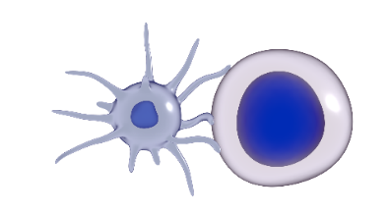

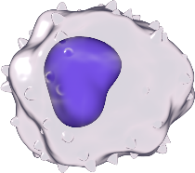

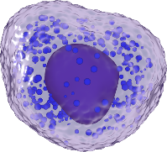



Pathways to Airway Eosinophilia and Eosinophil’s Role in Inflammation¹⁻⁸
Activated
airway
eosinophils
ALLERGENS
Th2
IL-5
IL-4
IL-13
TSLP
Dendritic cell
IL-5 & other
eosinophil-activating
cytokines
(eg. GM-CSF)
NON-SPECIFIC STIMULI
TSLP
Macrophage
Basophil
Mast cell
ILC2
Local eosinophil progenitor
Migration from
blood to lung tissue
BONE MARROW & BLOOD
IL-5
1. Denburg JA et al. CHEST. 2008;134:1037-1043; 2. Lambrecht BN et al. Nat Immunol. 2015;16:45-56; 3. Pelaia G et al. Nature. 2012;11:958-972; 4. Stone KD et al. J Allergy Clin Immunol. 2010;125:S73-S80; 5. Varricchi G et al. Front. Immunol. 2017;8:242; 6. Yang Z et al. PLoS ONE. 2013; 8: e59441; 7. Mukherjee M et al. World Allergy Organ J. 2014;7:32; 8. Pelaia G et al. Nat Rev Drug Discov. 2012;11:958-972.
Eosinophil progenitor
Circulating eosinophil
Notes:
Note:
Present slide.
Abbreviations:
GM-CSF = granulocyte-macrophage-colony stimulating factor; IL = interleukin; TSLP = thymic stromal lymphopoietin.
References:
Denburg JA and Keith PK. Eosinophil progenitors in airway diseases. CHEST. 2008;134:1037-1043.
Lambrecht BN and Hammad H. The immunology of asthma. Nat Immunol. 2015;16:45-56.
Pelaia G, Vatrella A, Maselli R. The potential of biologics for the treatment of asthma. Nature. 2012;11:958-972.
Stone KD, Prussin C, Metcalfe DD. IgE, mast cells, basophils, and eosinophils. J Allergy Clin Immunol. 2010;125:S73-S80.
Varricchi G, Senna G, Loffredo S, et al. Reslizumab and eosinophilic asthma: one step closer to precision medicine? Front. Immunol. 2017;8:242. http://dx.doi.org/10.3389/fimmu.2017.00242. Accessed September 3, 2018.
Yang Z, Grinchuk V, Urban JF, et al. Macrophages as IL-25/IL-33-responsive cells play an important role in the induction of type 2 immunity. PLoS ONE. 2013; 8: e59441. http://dx.doi.org/10.1371/journal.pone.00594412013. Accessed September 3, 2018.
Mukherjee M, Sehmi R, Nair P. Anti-IL5 therapy for asthma and beyond. World Allergy Organ J. 2014;4;7:32. eCollection 2014.
Pelaia G, Vatrella A, Maselli R. The potential of biologics for the treatment of asthma. Nat Rev Drug Discov. 2012;11:958-972.
Denburg/p 1038/col 1/para 1-2/col 2/para 3/p 1039/Fig 1/p 1041/Fig 2
Lambrecht 2015/p 45/ Col 2/ Para 2/ LN 1-4/p 47/Fig 2/p 46/col 2/para 2
Palaia/p 959/col 2/para 2/p 960/Fig 1
Stone/p S78/col 2/para 2
Varricchi/p 2/col 2/para 5/p 4/ln 13-18/para 5/ln 11-12/Fig 2/p 3/col 1/para 2
Yang/p 1/col 2/para 2/p 3/para 2/
Mukherjee/p 2/Fig 1A/notes
Pelaia2012/p 959/ col 2/ para 2/ ln 7-22; pg 960/ figure 1 & caption/ ln 2-6

Slide 14
Corticosteroid Resistance in Asthma Increases as Type 2 Inflammation Increases
Inadequate Response to OCS
Insensitivity to corticosteroids | Sensitivity to corticosteroids | Insensitivity to corticosteroids
Patients with Th2-low asthma and a subset of patients with Th2-high asthma are corticosteroid insensitive
Increase in steroid sensitive cells
Increase in steroid insensitive cells
IL-5
IL-13
IL-5
IL-13
Type 2 low | Type 2 high
IL = interleukin; OCS = oral corticosteroid; Th2 = type 2.
Dunican EM et al. Eur Respir J. 2017;49:1701167.
Notes:
Notes:
T2 cytokines such as IL-5 inhibit glucocorticoid-induced eosinophil apoptosis¹
Patients with asthma may have either Th2-low or Th2-high endotypes, as shown in the figure
Data have shown that those in the Th2-high endotype are likely to be more responsive to corticosteroids than those with Th2-low asthma; however, some patients with Th2-high asthma also may not respond well to corticosteroids, as shown on the far right of the figure¹
This may be because this subset of Th2-high patients have high levels of type 2 cytokines (eg interleukin 5, or IL-5),¹ which promote steroid resistance, as although corticosteroids cause eosinophil apoptosis, this effect is completely inhibited in eosinophils exposed to high-dose IL-5²
In these cases, targeting IL-5 becomes more effective than increasing steroid dose, which may help to explain the known clinical efficacy of anti-IL-5 inhibitors in these patients¹
References:
Dunican EM and Fahy JV. Asthma and corticosteroids: time for a more precise approach to treatment. Eur Respir J. 2017. https://doi.org/10.1183/13993003.01167-2017. Accessed September 24, 2018.
Pazdrak K, Moon Y, Straub C, et al. Eosinophil resistance to glucocorticoid-induced apoptosis is mediated by the transcription factor NFIL3. Apoptosis. 2016;21:421-431.

Slide 15
Elevated Eosinophils Are Commonly Observed in Patients With Asthma
Studies have shown that patients with...
ASTHMA
SEVERE ASTHMA
∼50%
∼50%
Have eosinophils present in sputum^{1,2}
Have elevated eosinophil levels in the airways³
1. Zhang JY et al. Immunol Allergy Clin North Am. 2007;27:623-632; 2. Schleich FN et al.Eur Respir J. 2014;44:97-108; 3. Wenzel S. Am J Respir Crit Care Med. 2005;172:149-160.
Notes:
Notes:
Eosinophils are present in the sputum of approximately 50% of all patients with asthma¹
Airway and bronchoalveolar lavage studies of patients with severe asthma suggest that approximately 50% of these patients have persistent large airway tissue eosinophils, despite continued treatment with high-dose systemic and inhaled steroids²
References:
Zhang JY, Wenzel SE. Tissue and BAL based biomarkers in asthma. Immunol Allergy Clin North Am. 2007;27:623-632.
Wenzel S. Severe asthma in adults. Am J Respir Crit Care Med. 2005;172:149-160.
Zhang 2007/p 624/para 1
Schleich 2014/p 104/para 3
Wenzel/p 153/col 1/para 2

Slide 16


Most Consistently Identifiable Features Associated With Eosinophilic Asthma
Clinical Presentation
Clinical Profile of Patients With Late-onset Eosinophilic Asthma¹
AT RISK OF SEVERE EXACERBATIONS
LOW FEV₁, OFTEN PERSISTENT AIRFLOW LIMITATION¹
CHRONIC RHINOSINUSITIS WITH NASAL POLYPOSIS¹
RESPONSE TO OCS¹
ADULT ONSET
Equal distribution between sexes¹
Elevated eosinophils in peripheral blood^{1,2}
FEV₁ = forced expiratory volume in 1 second; OCS = oral corticosteroid.
1. de Groot JC et al. ERJ Open Res. 2015;1:00024-2015; 2. Price DB et al. Lancet Respir Med. 2015;3:849-858.
Notes:
Note:
Present slide.
References:
de Groot JC, ten Brinke A, Bel EHD. Management of the patient with eosinophilic asthma: a new era begins [published correction in ERJ Open Res. 2015;1:00024-2016]. ERJ Open Res 2015;1:00024-2015. http://dx.doi.org/10.1183/23120541. Accessed September 11, 2018.
Price DB, Rigazio A, Campbell JD, et al. Blood eosinophil count and prospective annual asthma disease burden: a UK cohort study. Lancet Respir Med. 2015;3:849-858.

Slide 17

High Eosinophil Levels Are Associated With Poor Clinical Outcomes
Return to EOS
Clinical Profile
Severe
Exacerbations^{1,a}
Overall
Asthma Control^{1,a}
201–300 cells/µL (n=25,882)
301–400 cells/µL (n=15,030)
401–500 cells/µL (n=8659)
501–600 cells/µL (n=4928)
601–700 cells/µL (n=2726)
701–800 cells/µL (n=1631)
801–900 cells/µL (n=947)
901–1000 cells/µL (n=1019)
>1000 cells/µL (n=1019)
0.5
0.7
1.0
1.5
2.0
2.5
0.3
0.5
0.7
1.0
1.5
2.0
Adjusted RR
Adjusted OR
Patients with elevated eosinophil levels experience a higher rate of exacerbations
and lower asthma control despite treatment with standard of care¹⁻³
ªData from medical records of asthma patients aged 12-80 years. Patients assigned to 9 eosinophil count categories were compared with a reference category of ≤200 cells per μL (n=68,407).¹ Severe exacerbations defined as asthma-related hospitalization, attendance at an accident or emergency department, or a prescription for acute oral corticosteroids. Overall asthma control defined as absence of any acute respiratory event or asthma-related outpatient department visit + no evidence of SABA overuse (average daily dose of ≤200μg salbutamol or ≤500μg terbutaline).¹
EOS = eosinophil; OR = odds ratio; RR = rate ratio; SABA = short-acting B2 agonist.
1. Price DB et al. Lancet Respir Med. 2015;3:849-858; 2. de Groot JC et al. ERJ Open Res. 2016;2:00100-2015; 3. Zeiger RS et al. J Allergy Clin Immunol Pract. 2014;2:741-750.
Notes:
Note:
Present slide.
References:
Price DB, Rigazio A, Campbell JD, et al. Blood eosinophil count and prospective annual asthma disease burden: a UK cohort study. Lancet Respir Med. 2015; 3:849-858.
de Groot JC, ten Brinke A, Bel EHD. Management of the patient with eosinophilic asthma: a new era begins [published correction in ERJ Open Res. 2015;1:00024-2016]. ERJ Open Res 2015;1:00024-2015. http://dx.doi.org/10.1183/23120541. Accessed September 11, 2018.
Zeiger RS, Schatz M, Li Q, et al. High blood eosinophil count is a risk factor for future asthma exacerbations in adult persistent asthma. J Allergy Clin Immunol Pract. 2014;2:741-750.

Slide 18
Elevated Blood and Sputum Eosinophils Are Associated With Persistent Airflow Limitation in Severe Asthma
Return to EOS
Clinical Profile
Blood EOS Were Elevated in Patients With
Severe Persistent Airflow Obstruction¹
Persistent Airflow Limitation in Patients With
Severe Asthma Was ~8X More Common for Sputum EOS ≥2% vs. <2%²
1.4
 | Adjusted OR* | 95% CI
Sputum eosinophils ≥2% | 7.7 | (2.4-25.1)
PC₂₀histamine ≤1.0 mg/ml | 3.9 | (1.2-13.0)
Adult onset of asthma | 3.3 | (1.2-9.0)
Exhaled NO ≥10 ppb | 1.9 | (0.8-4.8)
Reversibility of FEV₁ ≥9% | 1.7 | (0.8-3.6)
Total lgE >100 IE/ml | 1.7 | (0.8-3.7)
Blood eosinophil count >450 x10⁶/L | 1.5 | (0.6-3.6)
Sputum neutrophils ≥64% | 1.4 | (0.5-4.0)
Ex-smoker | 1.3 | (0.6-2.9)
Atopic | 0.8 | (0.4-1.9)
***
1.2
1.0
0.8
Eosinophils 10⁹ cells•L⁻¹
0.6
0.4
0.2
0.0
<50% predicted
>80% predicted
Post bronchodilator FEV₁
*OR adjusted for age, sex, and asthma duration.
CI = confidence interval; NO = nitric oxide; PC₂₀histamine = provocative concentration of histamine causing a 20% decrease in FEV₁.
1. Bumbacea D et al. Eur Respir J. 2004;24:122-128; 2. ten Brinke A et al. Am J Respir Crit Care Med. 2001;164;744-748.
Notes:
Note:
Present slide.
References:
Bumbacea D, Campbell D, Nguyen L, et al. Parameters associated with persistent airflow obstruction in chronic severe asthma. Eur Respir J. 2004;24:122-128.
ten Brinke A, Zwinderman AH, Sterk PJ, et al. Factors associated with persistent airflow limitation in severe asthma. Am J Respir Crit Care Med. 2001;164;744-748.
Bumbacea 2004/p 125/ Fig 1b/p 126/col 2/ para 1
ten Brinke 2001/p 745/col 2/para 3-1,6/p 747/Table 3

Slide 19
Late-Onset Asthma Is Associated With Elevated Eosinophil Levels Without a Typical Th2 Pattern of Inflammation
Burden of Disease
Return to EOS
Clinical Profile
Relation of Age of Onset to Airway Inflammation¹
P=0.05
Late-onset is associated with:
Lower prevalence of allergen sensitivity and allergic symptoms¹
Supports a role for ILC2 cells²
Tendency towards lower lung function³
Increased prevalence of upper airway disease⁴
Early
P=0.05
Late
Cross-sectional analysis of patients with severe asthma (N=80)
ILC2 = type 2 innate lymphoid cell; Th2 = type 2 helper cell.
1. Miranda C et al. J Allergy Clin Immunol. 2004;113;101-108; 2. Brusselle GG et al. Nat Med. 2013;19:977-979; 3. Amelink M et al. J Allergy Clin Immunol. 2013;132:336-341; 4. de Groot JC et al. ERJ Open Res. 2016;2:00100-2015.
Notes:
Note:
Present slide.
References:
Miranda C, Busacker A, Balzar S, et al. Distinguishing severe asthma phenotypes: Role of age at onset and eosinophilic inflammation. J Allergy Clin Immunol. 2004;113;101-108.
Brusselle GG, Maes T, Bracke K. Eosinophilic airway inflammation in nonallergic asthma. Nat Med. 2013;19:977-979.
Amelink M, de Groot JC, de Nijs SB et al. Severe adult-onset asthma: A distinct phenotype. J Allergy Clin Immunol. 2013;132:336-341.
de Groot JC, ten Brinke A, Bel EHD. Management of the patient with eosinophilic asthma: a new era begins [published correction in ERJ Open Res. 2015;1:00024-2016]. ERJ Open Res 2015;1:00024-2015. http://dx.doi.org/10.1183/23120541. Accessed September 11, 2018.

Slide 20
High-Dose OCS Use Decreases Eosinophil Counts in Blood and Sputum
Blood eosinophil counts
Eosinophil counts in the sputum
Baseline EOS counts
290 cells/µL 250 cells/µL
Baseline EOS counts
3.7% 3.6%
Mild/ Moderate Asthma
N=23
Severe Asthma
N=45
Mild/ Moderate Asthma
N=12
Severe Asthma
N=18
75% decrease for both mild/moderate and severe asthma in blood EOS counts from baseline; p<0.0001
65% decrease for mild/moderate asthma and 78% decrease for severe asthma in sputum EOS cell counts from baseline; p<0.0001
Pooled analysis of US and UK open-labelª, parallel-group studies exploring changes in outcomes with 2 weeks of HD^{b} oral prednisolone steroids
in patients with mild/moderate asthma compared to severe asthma (N=82, patients with asthma)
ªThe two studies had essentially identical protocols. ^{b}Patients were treated with 0.5 mg /kg/day with a maximum dose of 40 mg/day of oral prednisolone for 14 days.
HD = high-dose.
Sousa AR et. Clin Exp Allergy. 2017;47:890-899.
Notes:
Note:
Present slide.
Additional Information:
The GINA framework and corticosteroid use were used to define the different asthma groups. 24% patients were on prednisolone before entering the study so that may explain the relatively low EOS count.
Reference:
Sousa AR, Marshall RP, Warnock LC, et al. Responsiveness to oral prednisolone in severe asthma is related to the degree of eosinophilic airway inflammation. Clin Exp Allergy. 2017;47:890-899.

Slide 21

Patients With Asthma and Nasal Polyps/Chronic Sinusitis Were Associated With Elevations in Sputum and Blood Eosinophils
Return to EOS
Clinical Profile
Eosinophil Levels in Asthma Patients With and Without Nasal Polyps¹
Patients With Severe Asthma + Sinus Disease²
Blood and sputum inflammatory parameters
Relationship between sinus CT scan score and level of FRC
200
Sputum
Blood
160
120
FRC (pred %)
80
40
Rs=0.47
p=0.002
0
5
10
15
20
25
30
CT scan score (0-30)
Figure adapted from ten Brinke A et al. J Allergy Clin Immunol. 2002;109:621-626
Older age
Shorter asthma duration/ adult onset
Increased blood and sputum EOS and FeNO
Evidence of air trapping
CT = computed tomography; EOS = eosinophil; FeNO = fractional exhaled nitric oxide; FRC = functional reserve capacity; pred = predicted; Rs = Spearman rank correlation coefficients.
1. Bilodeau L et al. Rhinology. 2010;48:420-425; 2. ten Brinke A et al. J Allergy Clin Immunol. 2002;109:621-626.
Comparative analysis of outcomes in the presence and absence of nasal polyps in Canadian patients with asthma (N=79)
Analysis of patients in the Netherlands with severe asthma and a history of episodic dyspnea and wheezing (N=89)
Notes:
Note:
Present slide.
References:
Bilodeau L, Boulay M-E, Prince P, et al. Comparative clinical and airway inflammatory features of asthma with or without nasal polyposis. Rhinology. 2010;48:420-425.
ten Brinke A, Grootendorst DC, Schmidt J, et al. Chronic sinusitis in severe asthma is related to sputum eosinophilia. J Allergy Clin Immunol. 2002;109:621-626.
Bilodeau/p 420/col 2/para 3 422/Table 2
ten Brinke/p 622/col 1/para 2/col 2 /para 4/p 624/Fig 3/col 1/para 2

Slide 22
Summary

Slide 23
Summary
Chronic OCS treatment for the management of patients with severe, eosinophilic asthma may not provide the most effective control of asthma conditions and its use is limited by an increase in adverse outcomes and health-care costs¹⁻³
Various clinical features aid in identifying patients with severe, eosinophilic asthma including frequent severe exacerbations, late onset disease, OCS dependence, fixed airflow obstruction, and an increased prevalence of nasal polyps and chronic sinusitis⁴⁻⁶
In the phenotype with corticosteroid insensitivity, targeting IL-5 may be a more appropriate option than increasing the steroid dose⁷
1. Sweeney J et al. Thorax. 2016;71:339-346; 2. Price DB et al. Supplementary methods. J Asthma Allergy. 2018;11:193-204; 3. Voorham J et al. Online ahead of print. Allergy. 2018; 4. Price DB et al. Lancet Respir Med. 2015;3:849-858; 5. Bilodeau L et al. Rhinology. 2010;48:420-425; 6. ten Brinke A et al. J Allergy Clin Immunol. 2002;109:621-626; 7.Dunican EM et al. Eur Respir J. 2017;49:1701167.
Notes:
Note:
Present slide.
References:
Sweeney J, Patterson CC, Menzies-Gow A, et al. Comorbidity in severe asthma requiring systemic corticosteroid therapy: cross-sectional data from the Optimum Patient Care Research Database and the British Thoracic Difficult Asthma Registry. Thorax. 2016;71:339-346.
Price DB, Trudo F, Voorham J et al. Adverse outcomes from initiation of systemic corticosteroids for asthma: long-term observational study [article and supplementary methods]. J Asthma Allergy. 2018;11:193-204.
Voorham J, Xu X, Price D, et al. Health care resource utilization and costs associated with incremental systemic corticosteroid exposure in asthma [published online ahead of print]. Allergy. 2018. http://dx.doi.org/10.1111/all.13556. Accessed September 3, 2018.
Price DB et al. Lancet Respir Med. 2015;3:849-858;
Bilodeau L, Boulay M-E, Prince P, et al. Comparative clinical and airway inflammatory features of asthma with or without nasal polyposis. Rhinology. 2010;48:420-425.
ten Brinke A, Grootendorst DC, Schmidt J, et al. Chronic sinusitis in severe asthma is related to sputum eosinophilia. J Allergy Clin Immunol. 2002;109:621-626.
Dunican EM and Fahy JV. Asthma and corticosteroids: time for a more precise approach to treatment Eur Respir J. 2017;49:1701167.

Slide 24
Global Medical Affairs Cover Sheet
Asset Name | <Generic Name: Title> | FASENRA: Place in Therapy and Pivotal Studies Medical Deck
Intended Use | <Reactive or Internal use> | Proactive
Approved for Distribution |  |  |  |  |  | Therapy Area | Respiratory
Asset Owner | Bhavini Parikh and William Cook |  |  |  |  | New or Updated | Updated
Document Number | ML-3034-ALL-0062 |  |  |  |  | Based on Asset (include Vault MedComms or PromoMats document number or N/A for not applicable) | Z4-13343
Approved Date | 12/18 |  | Expiration Date |  | 12/19
Technical Review/Fact Check Completed by Global Medical Information (Yes/No) |  |  |  | Yes |  | Applicable Copyright Permissions Obtained for Graphics (Yes/No) | Yes
This material is globally approved for use by AstraZeneca Medical Affairs Scientific Personnel only. The local market is responsible for interpreting, reviewing, and approving the content according to their local label, rules, and regulations.
Additional Disclaimers or Special Instructions: This slide deck is not intended for distribution.
External use of any of the content must be approved for release by your local nominated signatory/local medical process to ensure compliance with local regulations.
Refer to the General Properties for this asset in GMIP Content (Veeva Vault MedComms) for additional details.
Questions on this asset should be directed to asset owner.

Slide 25
FASENRA (benralizumab 30 mg subcutaneous injection)
Place in Therapy and Pivotal Studies
FASENRA is indicated as an add-on maintenance treatment in adult patients with severe eosinophilic asthma inadequately controlled despite high-dose inhaled corticosteroids plus long-acting β-agonists.
ML-3034-ALL-0062
12/18
12/19
FASENRA Summary of Product Characteristics.

Slide 26
FASENRA
Place in Therapy
Mechanism of Action

Slide 27
Benralizumab Has Been Added as Step 5 Treatment in GINA 2018
GINA
Step 5
Refer for add-on treatment (eg, tiotropium,^{a,d} anti-IgE,
anti-IL5)ª
Step 4
Med/High ICS/LABA
Preferred
controller
choice
Step 1
Step 2
Low-dose ICS
Step 3
Low-dose ICS/LABA^{b}
Add tiotropium^{a,d}
Med/High ICS + LTRA (or +theophylline)ª
Med/High ICS
Low-dose ICS + LTRA (or + theophylline)ª
Other
options
Consider
low-dose ICS
LTRA
Low-dose theophyllineª
Add
low-dose OCS
As needed: SABA
As needed: SABA or low-dose ICS/formoterol^{c}
Reliever
Step 5 add-on treatment options include:
anti-interleukin-5 receptor treatment (subcutaneous benralizumab for patients aged ≥12 years) with severe eosinophilic asthma that is uncontrolled on Step 4 treatment
ªNot for children <12 years. ^{b}For children 6-11 years, the preferred Step 3 treatment is medium-dose ICS. ^{c}Low-dose ICS/formoterol is the reliever medication for patients prescribed low-dose budesonide/formoterol or low-dose beclomethasone/formoterol maintenance and reliever therapy. ^{d}Tiotropium by mist inhaler is an add-on treatment for patients with a history of exacerbations; it is not indicated in children <12 years. GINA = Global Initiative for Asthma; ICS = inhaled corticosteroids; IgE = immunoglobulin E; IL5 = interleukin-5; LABA = long-acting β agonists; LTRA = leukotriene receptor agonist; OCS = oral corticosteroids; SABA = short-acting β agonists.
Global Initiative for Asthma (GINA) 2018. http://www.ginasthma.org.
Notes:
Note:
Benralizumab has been added to GINA 2018 Step 5 treatment.
Background: The GINA guidelines group together the IL-5 and IL-5R agents in the diagram but calls them out as different modalities in the full text. It is important to emphasize benralizumab’s mechanism of action of enhanced antibody-dependent cell-mediated cytotoxicity discussed in the next slides
Reference:
Global Initiative For Asthma (GINA). Global strategy for asthma management and prevention. Updated 2018. http://ginasthma.org/2018-gina-report-global-strategy-for-asthma-management-and-prevention//. Accessed September 11, 2018.

Slide 28








Benralizumab Mechanism of Action: Enhanced Antibody-Dependent Cell-Mediated Cytotoxicity
Benralizumab MOA
Benralizumab MOA In Vitro Fluorescence Imaging
Benralizumab MOD
Directly targets
IL-5Rα
NK Recruitment
Legend
Benralizumab
(IL-5Rα mAb)
FcγRIIIα
Benralizumab induces rapidª and near complete depletion of blood eosinophils¹⁻⁴
Afucosylated Fc region⁵
NK Cell
ACTIVE Eosinophil Apoptosis
Eosinophil
ADCC
ªBenralizumab induces eosinophil apoptosis within 6 hours in vitro³; blood eosinophils were depleted within 24 hours in a Phase 1 study.²
ADCC = antibody-dependent cell-mediated cytotoxicity; Fc region = fragment crystallizable region; IL-5Rα = interleukin 5 receptor alpha; mAb = monoclonal antibody; MOA = mechanism of action; NK = natural killer.
1. Kolbeck R et al. J Allergy Clin Immunol. 2010;125:1344-1353; 2. Laviolette M et al. J Allergy Clin Immunol. 2013;132:1086-1096; 3. Dagher R et al. Poster presented at: International Eosinophil Society 10th Biennial Symposium; July 19-23, 2017; Gothenburg, Sweden; 4. Tan L et al. J Asthma Allergy. 2016;9:71-81; 5. Busse WW, et al. In: Lee JJ, Rosenberg HF, eds. Eosinophils in Health and Disease. London, UK: Academic Press; 2013: 587-591.
Notes:
Notes:
Benralizumab Description
Benralizumab is a humanized afucosylated (IgG₁) anti‑interleukin‑5 receptor α monoclonal antibody.^{2,5,10} The IL‑5 receptor α is predominantly expressed on eosinophils and basophils.¹ Afucosylation of the Fc portion of the benralizumab antibody increases its affinity for the Fc receptor on natural killer cells and facilitates enhanced antibody‐dependent cell mediated cytotoxicity (ADCC)^{2,5, 8,10}
Benralizumab recruits natural killer cells to eosinophil (and basophil) targets that directly induce apoptosis via enhanced ADCC. This results without the release of toxic mediators such as eosinophil cationic protein (ECP) or eosinophil-derived neurotoxin (EDN)^{2,5,6,10}
Benralizumab induces direct, rapid, and near complete depletion of eosinophils in the blood; sampling of airway tissue, sputum, and bone marrow has confirmed near complete depletion in these relevant tissue compartments as well⁶⁻¹¹
Depletion of eosinophils is reversible following cessation of benralizumab therapy¹²
References:
Kolbeck R, Kozhich A, Koike M, et al. MEDI-563, a humanized anti-IL-5 receptor mAb with enhance antibody-dependent cell mediated cytotoxicity function. J Allergy Clin Immunol. 2010;125:1344-1353.
Laviolette M, Gossage DL, Gauvreau G, et al. Effects of benralizumab on airway eosinophils in asthmatic patients with sputum eosinophilia. J Allergy Clin Immunol. 2013;132:1086-1096.
Dagher R, Copenhaver A, Hanna R, et al. Investigation of natural killer cell-mediated eosinophil apoptosis by benralizumab [poster]. Presented at: International Eosinophil Society -10th Biennial Symposium; July 19-23, 2017; Gothenburg, Sweden.
Tan L, Bratt J, Godor D, et al. Benralizumab: a unique IL-5 inhibitor for severe asthma. J Asthma Allergy 2016;9:71-81.
Busse WW, Molfino NA, Kolbeck R. Interleukin-5 receptor-directed strategies. In: Lee JJ, Rosenberg HF,eds. Eosinophils in Health and Disease. London, UK: Academic Press; 2013: 587-591.
Bleecker ER, FitzGerald JM, Chanez P, et al. Efficacy and safety of benralizumab for patients with severe asthma uncontrolled with high-dosage inhaled corticosteroids and long acting β2-agonists (SIROCCO): a randomized, multicenter, placebo-controlled phase 3 trial. Lancet. 2016;388:2115-2127.
FitzGerald JM, Bleeker ER, Nair P, et al. Benralizumab, an anti-interleukin-5 receptor monoclonal antibody, as add-on treatment for patients with severe, uncontrolled, eosinophilic asthma (CALIMA): a randomized, double-blind, placebo-controlled phase 3 trial. Lancet. 2016;388:2128-2141.
Busse WW, Katial R, Gossage D, et al. Safety profile, pharmacokinetics, and biologic activity of MEDI-563, an anti–IL-5 receptor α antibody, in a phase I study of subjects with mild asthma. J Allergy Clin Immunol. 2010;125:1237-1244.
Laviolette M, Gossage DL, Gauvreau G, et al. Effects of benralizumab on airway eosinophils in asthma with sputum eosinophilia. J Allergy Clin Immunol. 2013;132:1086-1096.
Pham TH, Damera G, Newbold P, et al. Reductions in eosinophil biomarkers by benralizumab in patients with asthma. Respir Med. 2016;111:21-29.
Nair P, Wenzel S, Rabe KF, et al. Oral glucocorticoid-sparing effect of benralizumab in severe asthma [supplementary appendix]. N Engl J Med. 2017;376:2448-2458. http://dx.doi.org/10.1056/NEJMoa1703501. Accessed September 11, 2018.
Castro MC, Wenzel SE, Bleecker ER, et al. Benralizumab, an anti-interleukin 5 receptor α monoclonal antibody, versus placebo for uncontrolled eosinophilic asthma: a phase 2b randomised dose-ranging study. Lancet Respir Med. 2014;2:879-890.

Slide 29
The Role of Eosinophils in the Pathophysiology of Eosinophilic Asthma¹⁻⁸
Activated
airway
eosinophils
ALLERGENS
Th2
IL-5
IL-4
IL-13
TSLP
Dendritic cell
IL-5 & other
eosinophil-activating
cytokines
(eg. GM-CSF)
NON-SPECIFIC STIMULI
TSLP
Macrophage
Basophil
Mast cell
ILC2
Local eosinophil progenitor
Migration from
blood to lung tissue
BONE MARROW & BLOOD
IL-5
GM-CSF = granulocyte-macrophage-colony stimulating factor; TSLP = thymic stromal lymphopoietin.
1. Denburg JA et al. CHEST. 2008;134:1037-1043; 2. Lambrecht BN et al. Nat Immunol. 2015;16:45-56; 3. Pelaia G et al. Nature. 2012;11:958-972; 4. Stone KD et al. J Allergy Clin Immunol. 2010;125:S73-S80; 5. Varricchi G et al. Front. Immunol. 2017;8:242; 6. Yang Z et al. PLoS ONE. 2013;8: e59441; 7. Mukherjee M et al. World Allergy Organ J. 2014;7:32; 8. Pelaia G et al. Nat Rev Drug Discov. 2012;11:958-972.
Eosinophil progenitor
Circulating eosinophil
Notes:
Note:
Present slide.
References:
Denburg JA and Keith PK. Eosinophil progenitors in airway diseases. CHEST. 2008;134:1037-1043.
Lambrecht BN and Hammad H. The immunology of asthma. Nat Immunol. 2015;16:45-56.
Pelaia G, Vatrella A, Maselli R. The potential of biologics for the treatment of asthma. Nature. 2012;11:958-972.
Stone KD, Prussin C, Metcalfe DD. IgE, mast cells, basophils, and eosinophils. J Allergy Clin Immunol. 2010;125:S73-S80.
Varricchi G, Senna G, Loffredo S, et al. Reslizumab and eosinophilic asthma: one step closer to precision medicine? Front. Immunol. 2017;8:242. http://dx.doi.org/10.3389/fimmu.2017.00242. Accessed September 3, 2018.
Yang Z, Grinchuk V, Urban JF, et al. Macrophages as IL-25/IL-33-responsive cells play an important role in the induction of type 2 immunity. PLoS ONE. 2013; 8: e59441. http://dx.doi.org/10.1371/journal.pone.00594412013. Accessed September 3, 2018.
Mukherjee M, Sehmi R, Nair P. Anti-IL5 therapy for asthma and beyond. World Allergy Organ J. 2014;4;7:32. eCollection 2014.
Pelaia G, Vatrella A, Maselli R. The potential of biologics for the treatment of asthma. Nat Rev Drug Discov. 2012;11:958-972.

Slide 30
Benralizumab Mechanism of Action: In Vitro Fluorescence Imaging
Benralizumab MOA
Return to MOA
Benralizumab binds to IL-5Ra on eosinophil and directs NK to target eosinophil, forming immunological synapse between eosinophil and NK cell
Migration of NK lytic granules (green lysotracker) to target cell’s surface
NK granules fuse with eosinophil membrane, resulting in delivery of cytolytic mediators at the cellular interface
Eosinophil apoptosis demonstrated by target membrane blebbing and nuclear collapse
IL-5Ra = interleukin-5 receptor alpha; NK = natural killer.
Dagher R et al. Poster presented at: International Eosinophil Society 10th Biennial Symposium; July 19-23, 2017; Gothenburg, Sweden.
Eosinophil
NK Cell
Nuclear death
Notes:
Note:
Present each step in the slide
Reference:
Dagher R, Copenhaver A, Hanna R, et al. Investigation of natural killer cell-mediated Eosinophil apoptosis by benralizumab [poster]. Presented at: International Eosinophil Society -10th Biennial Symposium; July 19-23, 2017; Gothenburg, Sweden.

Slide 31
Rapid Blood Eosinophil Depletion in 24 Hours
Benralizumab MOA
Phase IIa (CP197): Change in Blood EOS From Baseline
1.00
Placebo
Benralizumab 25 mg
0.75
Administration of benralizumab 25 mg SC reduced peripheral blood EOS levels from Day 1 to Day 84
Median Blood EOS Counts, 10³/µL
0.50
0.25
LOD
0.00
0
20
40
60
80
100
120
140
160
180
Days
Administration of benralizumab or placebo on Days 0, 28, and 56
Multicenterª randomized, double-blind, placebo-controlled, Phase IIa study of adults with mild to moderate asthma (N=24)
ªThis study tested 25 mg of benralizumab, which is not the labeled dose of FASENRA (benralizumab 30 mg).
EOS = eosinophils; LOD = limit of detection for assay; SC = subcutaneous.
Pham TH et al. Respir Med. 2016;111:21-29.
Notes:
Note:
Present slide.
Reference:
Pham TH, Damera G, Newbold P, et al. Reductions in eosinophil biomarkers by benralizumab in patients with asthma. Respir Med. 2016;111:21-29.

Slide 32
Reduction of Mean Blood EOS Counts Maintained in Patients Continuously Exposed to Benralizumab for up to 2 Years
BORA
Phase III (BORA) Extension Study of SIROCCO and CALIMA Patients (≥300 cells/µL): Change in Blood EOS From the BORA Baseline
Off-treatment period
Mean Change From Baseline Blood EOS Counts (cells/µL)
300
Q8W/Q8W
200
Continuously
exposed
100
0
-100
PBO/Q8W
-200
New to benralizumab
-300
-400
-500
28
68
Week
There was sustained depletion of blood EOS counts throughout the treatment period and gradual recovery of EOS
during the off treatment period in both groups
Busse WW et al. Supplementary material online ahead of print. Lancet Respir Med. 2018.
Notes:
Note:
Present slide.
Abbreviations:
EOS = eosinophil; PBO = placebo; Q8W = every 8 weeks.
Reference:
Busse WW, Bleecker ER, FitzGerald JM, et al. Long-term safety and efficacy of benralizumab in patients with severe, uncontrolled asthma: 1-year results from the BORA phase 3 extension trial [supplementary material published online ahead of print November 7, 2018]. Lancet Respir Med. 2018. http://dx.doi.org/10.1016/S2213-2600(18)30406-5. Accessed November 8, 2018.

Slide 33
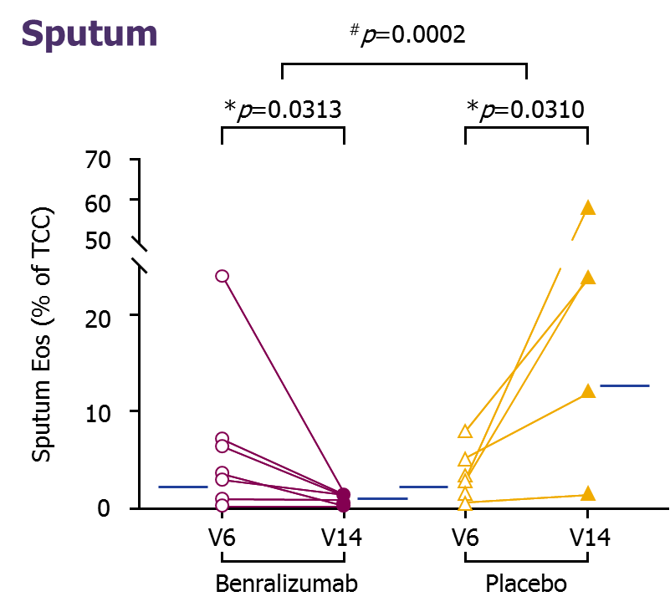
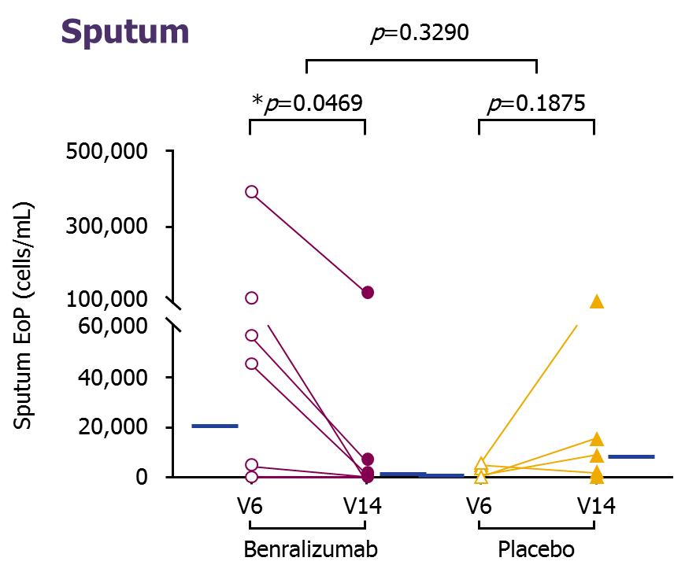
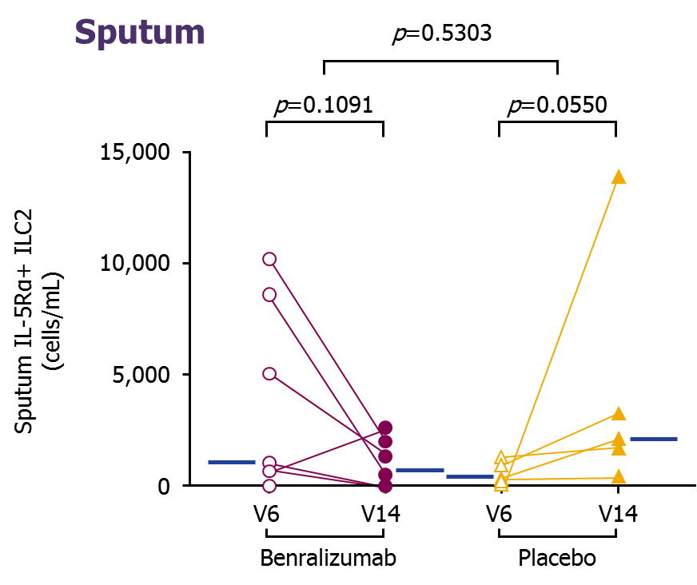
ZONDA Sputum Substudy: Benralizumab Depleted Mature Sputum EOS and Reduced Sputum EOS Progenitors and ILC2 Cells
Benralizumab MOA
Mature Sputum Eosinophils
Sputum Eosinophil Progenitors
Sputum IL-5Rα+ ILC2 Cells
ª
^{b}
^{b}
^{b}
Week 0
Week 28
Week 0
Week 28
Week 0
Week 28
Week 0
Week 28
Week 0
Week 28
Week 0
Week 28
(n=10)
(n=7)
(n=7)
(n=5)
(n=7)
(n=5)
Randomized, double-blind, 4-center, Canadian substudy of the Phase III ZONDA trial evaluating patients with severe asthma
and high blood EOS (≥150 cells/μL currently) on OCS therapy comparing pooled benralizumab 30 mg SC patients (n=11; Q4W [n=4] or Q8W [ n=7]) with placebo patients Q4W (n=7)
ªBetween-group significance. ^{b}Within-group significance.
EOS = eosinophil; ILC2 = type 2 innate lymphoid cells; IL-5Rα = interleukin-5 receptor alpha; MOA = mechanism of action; Q4W = every 4 weeks; Q8W = every 8 weeks (every 4 weeks for the first 3 doses); SC = subcutaneous.
Sehmi R et al. J Allergy Clin Immunol. 2018;141:1529-1532.e8.
Notes:
Note:
In a small substudy of ZONDA, benralizumab 30 mg depleted mature sputum eosinophils and reduced sputum eosinophil progenitors and ILC2 cells compared to placebo.
Reference:
Sehmi R, Lim HF, Mukherjee M, et al. Benralizumab attenuates airway eosinophilia in prednisone-dependent asthma. J Allergy Clin Immunol. 2018;141:1529-1532.e8.

Slide 34
Pivotal Studies: Overview

Slide 35
Exacerbation Studies (SIROCCO and CALIMA): Overview
Sirocco and CALIMA
Randomized, double-blind, placebo-controlled study evaluating the efficacy and safety of benralizumab in adults and adolescents with asthma inadequately controlled on medium- to high-dosage ICS/LABA^{1,2}
Benralizumab 30 mg Q4W
≥12 years with ≥2 historical exacerbations, ACQ-6 ≥1.5, FEV₁ <80% predicted, post-BD reversibility of ≥12% (N=2510)ª
PRIMARY ANALYSIS POPULATION
Blood eosinophils ≥300 cells/μL on high-dose ICS/LABA (N=1537)
SIROCCO 48-week study | CALIMA 56-week study
Patient Population
Benralizumab 30 mg Q4W
(1st 3 doses); Q8W^{b}
Randomization
Placebo
Primary Endpoint
Secondary Endpoints^{c}
Annual asthma exacerbation rate
Pre-BD FEV₁ (L)
ACQ-6 score
AQLQ(S)+12 score
ªTotal population from SIROCCO and CALIMA studies. ^{b}Licensed dosing regimen.³ ^{c}Select secondary endpoints listed.
ACQ = Asthma Control Questionnaire; AQLQ[S]+12= Standardized Asthma Quality of Life Questionnaire for patients 12 years and older; BD = bronchodilator; FEV₁ = forced expiratory volume in 1 second; ICS = inhaled corticosteroid; LABA = long-acting beta-agonist; Q4W = every 4 weeks; Q8W = every 8 weeks.
1. FitzGerald JM et al. Lancet. 2016;388:2128-2141; 2. Bleecker ER et al. Lancet. 2016;388:2115-2127; 3. Fasenra Summary of Product Characteristics.
Notes:
Note:
Present slide.
Additional Information:
While 2 dosing regimens were studied in Trials 1 (SIROCCO), 2 (CALIMA), and 3 (ZONDA), the recommended dosing regimen is Fasenra administered every 4 weeks for the first 3 doses, then every 8 weeks thereafter (see section 4.2) as no additional benefit was observed by more frequent dosing
References:
Bleecker ER, FitzGerald JM, Chanez P, et al. Efficacy and safety of benralizumab for patients with severe asthma uncontrolled with high-dosage inhaled corticosteroids and long-acting β₂-agonists (SIROCCO): a randomised, multicentre, placebo‑controlled phase 3 trial. Lancet. 2016;388:2115-2127.
FitzGerald JM, Bleecker ER, Nair P, et al. Benralizumab, an anti–interleukin-5 receptor α monoclonal antibody, as add-on treatment for patients with severe, uncontrolled, eosinophilic asthma (CALIMA): a randomised, double-blind, placebo-controlled phase 3 trial. Lancet. 2016;388:2128-2141.
Fasenra Summary of Product Characteristics.

Slide 36
Oral Corticosteroid Reduction Trial (ZONDA): Overview
ZONDA
Randomized, double-blind, placebo-controlled study assessing the ability of benralizumab to reduce OCS dosage in patients with severe refractory asthma and elevated eosinophils who are OCS dependent¹
28-week study
OCS reduction was performed Q4W per protocol
Benralizumab 30 mg Q4W
≥18 years with ≥1 historical exacerbations, OCS therapy (7.5-40 mg/d of prednisolone/prednisone equivalents) ≥6 continuous months directly preceding enrollment, FEV₁ <80% predicted, blood eosinophils ≥150 cells/μL (n=220)ª
Patient Population
Benralizumab 30 mg Q4W
(1st 3 doses); Q8W^{b}
Randomization
Placebo
Median percentage change in final OCS dose compared with baseline, while maintaining asthma control
Primary Endpoint
Annual asthma exacerbation rate
Change from pre-BD FEV₁ (L)
ACQ-6 score
AQLQ(S)+12 score
Secondary Endpoints^{c}
ªTotal population from the ZONDA study. ^{b}Licensed dosing regimen.² ^{c}Select secondary endpoints listed.
ACQ = Asthma Control Questionnaire; AQLQ[S]+12 = Standardized Asthma Quality of Life Questionnaire for patients 12 years and older; BD = bronchodilator; FEV₁ = forced expiratory volume in 1 second; OCS = oral corticosteroid; Q4W = every 4 weeks; Q8W = every 8 weeks.
1. Nair P et al. Article and supplementary appendix. N Engl J Med. 2017;376:2448-2458; 2. Fasenra Summary of Product Characteristics.
Notes:
Note:
Present slide.
Additional Information:
While 2 dosing regimens were studied in Trials 1 (SIROCCO), 2 (CALIMA), and 3 (ZONDA), the recommended dosing regimen is Fasenra administered every 4 weeks for the first 3 doses, then every 8 weeks thereafter (see section 4.2) as no additional benefit was observed by more frequent dosing
References:
Nair P, Wenzel S, Rabe KF, et al. Oral glucocorticoid-sparing effect of benralizumab in severe asthma. N Engl J Med. 2017;376:2448-2458.
FASENRA Summary of Product Characteristics.

Slide 37
Patient Flow From SIROCCO/CALIMA/ZONDA (BORA): Overview
SIROCCO 48-week study
CALIMA 56-week study
BORA
ZONDA 28-week study
BORA 56-week (adults) or
108-week (adolescents) study
Benralizumab 30 mg Q4W
Continue benralizumab 30 mg Q4W/Q4W
Benralizumab 30 mg Q8W
Continue benralizumab 30 mg Q8W/Q8W
Placebo
Start benralizumab 30 mg PBO/Q4W
Randomization^{a,b}
Start benralizumab
30 mg PBO/Q8W
(30 mg Q4W first 3 doses)
ªEligible patients transition from the predecessor study into BORA at the EOT visit of the predecessor study; ^{b}Adolescents on active treatment in the European Union will continue on the Q8W regimen. EOT = end of treatment.
Busse WW et al. Article online ahead of print. Lancet Respir Med. 2018.
Notes:
Note:
Present slide.
Abbreviations:
EOT = end of treatment; PBO = placebo; Q4W = every 4 weeks; Q8W = every 8 weeks
Reference:
Busse WW, Bleecker ER, FitzGerald JM, et al. Long-term safety and efficacy of benralizumab in patients with severe, uncontrolled asthma: 1-year results from the BORA phase 3 extension trial [published online ahead of print November 7, 2018]. Lancet Respir Med. 2018. http://dx.doi.org/10.1016/S2213-2600(18)30406-5. Accessed November 8, 2018.

Slide 38
Efficacy: Benralizumab’s Reduction of Exacerbations and OCS-Sparing Effect

Slide 39
Benralizumab Significantly Reduced Annual Exacerbation Rate
SIROCCO & CALIMA
AER by Baseline EOS
AER by Exacerbation History
-51%ª
-28%^{b}
Placebo
Benralizumab
AER Comparison with BORA
Annual Exacerbation Adjusted Rate
n=267
n=267
n=248
n=239
SIROCCO (48 weeks)^{1,2}
CALIMA (56 weeks)^{1,3}
Result for EOS ≥300 cells/µL
Benralizumab led to a significant reduction in AER compared to placebo in the SIROCCO and CALIMA trials.¹⁻³
Note: FASENRA is indicated as an add-on maintenance treatment in adult patients with severe eosinophilic asthma inadequately controlled despite high-dose inhaled corticosteroids plus long-acting beta-agonists.¹ Analysis via negative binomial model, including covariates treatment group, region, number of exacerbations in the previous year, and use of maintenance OCS.^{2,3} ªRate ratio = 0.49 (0.37-0.64; p<0.0001; ^{b}Rate ratio= 0.72 (0.54-0.95; p=0.019). AER = annual exacerbation rate; EOS = baseline blood eosinophil count.
1. FASENRA Summary of Product Characteristics; 2. Bleecker ER et al. Lancet. 2016;388:2115-2127; 3. FitzGerald JM et al. Lancet. 2016;388:2128-2141.
Notes:
Note:
Patients on high-dose ICS/LABA and with a baseline blood eosinophil count ≥300 cells/μL who were treated with benralizumab experienced significant annual exacerbation rate reductions relative to placebo in both the SIROCCO and CALIMA studies.¹⁻³
Additional Information:
Analysis via negative binomial model, including covariates treatment group, region, number of exacerbations in the previous year, and use of maintenance oral corticosteroids.^{2,3}
References:
Fasenra Summary of Product Characteristics.
Bleecker ER, FitzGerald JM, Chanez P, et al. Efficacy and safety of benralizumab for patients with severe asthma uncontrolled with high-dosage inhaled corticosteroids and long-acting β₂-agonists (SIROCCO): a randomised, multicentre, placebo‑controlled phase 3 trial. Lancet. 2016;388:2115-2127.
FitzGerald JM, Bleecker ER, Nair P, et al. Benralizumab, an anti–interleukin-5 receptor α monoclonal antibody, as add-on treatment for patients with severe, uncontrolled, eosinophilic asthma (CALIMA): a randomised, double-blind, placebo-controlled phase 3 trial. Lancet. 2016;388:2128-2141.

Slide 40
Annual Asthma Exacerbation Rates Were Lower with 2 Years of Treatment
SIROCCO CALIMA
BORA
Crude Annual Rate
Crude Annual Rate
74% of patients continuing benra Q8W in BORA were exacerbation free
72% of all patients receiving benra Q8W (new and continued) were exacerbation free
N=267
N=267
N=248
N=239
N=188
N=339
N=248
N=241
N=239
N=267
N=275
N=267
PBO
Q8W
PBO
Q8W
PBO/Q8W
Q8W/Q8W
New to benra
Continued on benra
SIROCCO^{1a}
CALIMA^{2a}
BORA^{3b}
ªCrude rates are presented here from the post-hoc analysis; which differs from the adjusted rate (0.65-0.66) in the primary publications.³ ^{b}In BORA safety extension study, asthma exacerbation rate was a secondary endpoint and is presented as descriptive data.
1. Bleecker ER et al. Supplementary appendix. Lancet. 2016;388;2128-2141; 2. FitzGerald JM et al. Supplementary appendix. Lancet. 2016;388;2128-2141; 3. Busse WW et al. Article online ahead of print. Lancet Respir Med. 2018.
Please note that as head-to-head studies were not conducted between these studies it is inappropriate to make direct comparisons as the study design, demographics, and other criteria may be different.
Notes:
Note:
Present slide.
Abbreviations:
benra = benralizumab; PBO = placebo; Q4W = every 4 weeks. Q8W = every 8 weeks.
References:
FitzGerald JM, Bleecker ER, Nair P, et al on behalf of the CALIMA study investigators. Benralizumab, an anti-interleukin-5 receptor α monoclonal antibody, as add-on treatment for patients with severe, uncontrolled, eosinophilic asthma (CALIMA): a randomised, double-blind, placebo-controlled phase 3 trial [supplementary appendix]. Lancet. 2016;388: 2128-2141. http://dx.doi.org/10.1016/S0140-6736(16)31322-8. Accessed August 17,2018.
Bleecker ER, FitzGerald JM, Chanez P, et al on behalf of the SIROCCO study investigators. Efficacy and safety of benralizumab for patients with severe asthma uncontrolled with high-dosage inhaled corticosteroids and long-acting β2-agonists (SIROCCO): a randomised, multicentre, placebo-controlled phase 3 trial [supplementary appendix]. Lancet. 2016; 388: 2115–2127. http://dx.doi.org/10.1016/ S0140-6736(16)31324-1. Accessed August 17, 2018.
Busse WW, Bleecker ER, FitzGerald JM, et al. Long-term safety and efficacy of benralizumab in patients with severe, uncontrolled asthma: 1-year results from the BORA phase 3 extension trial [published online ahead of print November 7, 2018]. Lancet Respir Med. 2018. http://dx.doi.org/10.1016/S2213-2600(18)30406-5. Accessed November 8, 2018.

Slide 41
Greater Improvements in Exacerbation Reduction With Benralizumab vs. Placebo With Increasing Baseline Blood Eosinophil Levels
SIROCCO & CALIMA
Return to AER
Pooled SIROCCO/CALIMA: Benralizumab AER Reduction vs. Placebo by Cumulative Blood EOS¹
AER Ratio vs. Placebo
EOS ≥0
EOS ≥150
EOS ≥300
EOS ≥450
cells/µL
Placebo, n=
Benralizumab, n=
770
751
648
646
511
499
306
298
Notes: FASENRA is indicated as an add-on maintenance treatment in adult patients with severe eosinophilic asthma inadequately controlled despite high-dose inhaled corticosteroids plus long-acting beta-agonists.² Values within the bars represent difference in rate ratio vs. placebo. Data are from the pooled ITT population (aged 12-75 years) receiving high-dose ICS/LABA from SIROCCO and CALIMA.¹ ITT = intention-to-treat. AER = annual exacerbation rate.¹
1. FitzGerald JM et al. Lancet Respir Med. 2018;6:51-64; 2. FASENRA Summary of Product Characteristics.
Notes:
Notes:
A pooled analysis of 2 Phase III asthma exacerbation studies (SIROCCO and CALIMA) showed a benefit in AER reduction from benralizumab treatment across the full spectrum of blood eosinophil counts in patients (aged 12-75 years) with severe uncontrolled asthma. Benralizumab patients experienced 36%-50% reductions in AER versus placebo¹
Efficacy with respect to AER increased with greater elevations of baseline blood eosinophil counts
Abbreviations:
EOS = baseline blood eosinophils; ICS = inhaled corticosteroids; LABA = long-acting beta agonist.
References:
FitzGerald JM, Bleecker ER, Menzies-Gow A, et al. Predictors of enhanced response with benralizumab for patients with severe asthma: pooled analysis of the SIROCCO and CALIMA studies. Lancet Respir Med.2018;6:51-64.
Fasenra Summary of Product Characteristics.

Slide 42
Greater Improvements in Exacerbation Reduction With Benralizumab vs. Placebo in Increasing Number of Historical Asthma Exacerbations
SIROCCO & CALIMA
Return to AER
Pooled SIROCCO/CALIMA: Benralizumab AER Reduction vs. Placebo¹
ARR: -98
ARR: -49
AER Reduction vs. Placebo, %
ARR: -22
Number of prior exacerbations
Placebo, n=
Benralizumab, n=
300
308
511
499
215
198
AER based on 2, ≥2, or ≥3 exacerbations over the previous 12 months in patients with baseline EOS counts of ≥300 cells/µL
Fasenra is indicated as an add-on maintenance treatment in adult patients with severe eosinophilic asthma inadequately controlled despite high-dose inhaled corticosteroids plus long-acting beta-agonists.² ªp< 0.0001 relative to placebo (nominal). Results are descriptive.
AER = annual exacerbation rate; ARR = absolute rate reduction.
1. FitzGerald JM et al. Lancet Respir Med. 2018;6:51-64; 2. FASENRA Summary of Product Characteristics.
Notes:
Note:
The size of the benralizumab treatment effect on AER increased with increasing number of historical asthma exacerbations
Abbreviations:
; EOS = eosinophil.
References:
FitzGerald JM, Bleecker ER, Menzies-Gow A, et al. Predictors of enhanced response with benralizumab for patients with severe asthma: pooled analysis of the SIROCCO and CALIMA studies. Lancet Respir Med.2018;6:51-64.
Fasenra Summary of Product Characteristics.

Slide 43
Exacerbation Rate Reduction Based on Clinical Predictors of Response (≥300 EOS)
Responder 2
Pooled SIROCCO/CALIMA (Responder 2): Benralizumab AER by Baseline Factors
FAS 42ª
AER Reduction vs. Placebo (%)
n=77
n=429
n=115
n=391
n=124
n=381
n=198
n=308
n=356
n=150
OCS use
Nasal polyps
Age at diagnosis (years)
There was an enhanced reduction in AER in patients with any key baseline characteristic and high blood EOS counts (≥300 cells/µL) relative to the FAS
All p-values were nominal. ªp<0.001. ^{b}p>0.01 to ≤0.05.
Bleecker ER et al. Eur Respir J. 2018;18:52.
Notes:
Note:
Present slide.
Abbreviations:
AER = asthma exacerbation rates; BD = bronchodilator; EOS = eosinophil; FAS = full analysis set; FVC = forced vital capacity; ICS = inhaled corticosteroid; LABA = long-acting β₂-agonist; OCS = oral corticosteroids; Q8W = every 8 weeks (first three doses every 4 weeks).
Reference:
Bleecker ER, Wechsler ME, FitzGerald JM et al. Baseline patient factor impact on the clinical efficacy of benralizumab for severe asthma. Eur Respir J. 2018. http://dx.doi.org/10.1183/13993003.00936-2018. Accessed October 25, 2018.

Slide 44
Exacerbation Rate Reduction Based on Clinical Predictors of Response (<300 EOS cells/µL )
Responder 2
Pooled SIROCCO/CALIMA (Responder 2)
AER Reduction vs. Placebo (%)
FAS 27^{b}
n=33
n=33
n=223
n=20
n=236
n=60
n=195
n=82
n=174
n=172
n=84
n=223
n=20
n=236
n=60
n=195
n=82
n=174
n=172
n=84
OCS use
Nasal polyps
Age at diagnosis (years)
In patients with <300 cells/ µL, current OCS use, nasal polyps and pre-BD FVC <65% had the greatest impact on AER reductions
All p-values were nominal. ªp≥0.001 to ≤0.01. ^{b}p>0.01 to ≤0.05.
Bleecker ER et al. Eur Respir J. 2018;18:52.
Notes:
Note:
Present slide.
Abbreviations:
AER = asthma exacerbation rates; BD = bronchodilator; EOS = eosinophil; FAS = full analysis set; FVC = forced vital capacity; ICS = inhaled corticosteroid; LABA = long-acting β₂-agonist; OCS = oral corticosteroids; Q8W = every 8 weeks (first three doses every 4 weeks).
Reference:
Bleecker ER, Wechsler ME, FitzGerald JM et al. Baseline patient factor impact on the clinical efficacy of benralizumab for severe asthma. Eur Respir J. 2018. http://dx.doi.org/10.1183/13993003.00936-2018. Accessed October 25, 2018.

Slide 45
Benralizumab Demonstrated Exacerbation Reductions Independent of Allergic Status (Atopy and IgE Concentration)
SIROCCO & CALIMA
SIROCCO & CALIMA
100
46
37
26
37
39
31
-10
<300 cells/μL
n=112e
Fasenra is indicated as an add-on maintenance treatment in adult patients with severe eosinophilic asthma inadequately controlled despite high-dose inhaled corticosteroids plus long-acting beta-agonists.² Data are from the pooled adult intention-to-treat population from the high-dosage ICS/LABA treatment cohorts of the SIROCCO and CALIMA studies.¹ Estimates were calculated by using a negative binomial model, with adjustment for study code, treatment, region, oral corticosteroid use at time of randomization, and prior exacerbations. The log of each patient’s corresponding follow-up time was used as an offset variable in the model to adjust for patients’ having different exposure times during which the events occurred.¹
ªNominal p=0.0002. ^{b}Nominal p<0.0001. ^{c}Nominal p=0.0257. Results are descriptive. ^{d}Adapted from criteria similar to those for patients who might qualify for omalizumab treatment. ^{e}Atopy (by Phadiatop test) and serum IgE concentration of 30-700 kU/L criteria. ^{f}Did not meet atopy and IgE 30-700 kU/L criteria.
1. Chipps BE et al. Ann Allergy Asthma Immunol. 2018;120:504-511.e4; 2. FASENRA Summary of Product Characteristics.
Notes:
Notes:
Baseline EOS counts ≥300 cells/μL slightly favor the atopic patient (The point in the blue box is very important).
Benralizumab, when combined with high-dosage ICS/LABA, reduced exacerbation frequency in patients with severe, uncontrolled asthma who met the criteria of atopy and serum IgE 30-700 kU/L. These criteria are similar to those that may qualify a patient for treatment with omalizumab.
The rate reduction was greater for patients with blood EOS counts that were ≥300 cells/μL versus those that were <300 cells/μL.
Abbreviations:
EOS = eosinophil; ICS = inhaled corticosteroids; IgE = immunoglobulin E; LABA = long-acting β2-agonists.
References:
Chipps BE, Newbold P, Hirsch I, et al. Benralizumab efficacy by atopy status and serum immunoglobulin E for patients with severe, uncontrolled asthma. Ann Allergy Asthma Immunol. 2018. 2018;120:504-511.e4.
Fasenra Summary of Product Characteristics.

Slide 46
Benralizumab Significantly Reduced OCS Doses While Maintaining Asthma Control at Week 28 in Patients With Severe Asthma vs. Placebo
ZONDA
n=75
n=73
Median Reduction in Daily
OCS Dose at Week 28, %
Reduction in Final OCS Dose at Week 28 | Benralizumab n=73 | Placebo n=75
Analysis of percentage reduction from baseline in OCS dose, OR (95% CI) | 4.12 (2.22–7.63) | ─
Reduction in daily OCS dose to 0 mg/day, n (%)ª | 22 (52%) | 8 (19%)
OR (95% CI) | 4.19 (1.58-11.12)
Placebo
Benralizumab
p<0.001
ªOnly patients with an optimized baseline OCS dose of 12.5 mg or less were eligible to achieve a 100% reduction in OCS dose during the study.
Nair P et al. N Engl J Med. 2017;376:2448-2458.
Notes:
Notes:
The primary endpoint of percentage reduction in OCS dosage from baseline to final dosage at end of therapy (Week 28), while maintaining asthma control, was 75% (median percent reduction) in the benralizumab group compared to 25% in the placebo group
Odds ratio: 4.12 (95% CI, 2.22-7.63) for the benralizumab group
Abbreviations:
CI = confidence interval; OCS = oral corticosteroid; OR = odds ratio.
Reference:
Nair P, Wenzel S, Rabe KF, et al. Oral glucocorticoid-sparing effect of benralizumab in severe asthma. N Engl J Med. 2017;376:2448-2458.

Slide 47
Benralizumab Reduced Annual Exacerbation Rate While Reducing Background OCS Use
ZONDA
Exacerbations Over
28 Weeks¹
Exacerbations Requiring Hospitalization or ED Visit Over 28 Weeks¹
Placebo
Benralizumab
-70% (p<0.001ª)
-93% (p=0.02ª)
AER (rate ratio)
Annual Estimated Rate
n=75
n=73
n=75
n=73
Secondary Endpoint: Annual asthma exacerbation rates were reduced with benralizumab by 70% (95% CI, 0.17-0.53; p<0.001) vs. placebo
benralizumab also reduced the AER associated with an ED visit or hospitalization by 93% (RR, 0.07; p=0.02)
Notes: Fasenra is indicated as an add-on maintenance treatment in adult patients with severe eosinophilic asthma inadequately controlled despite high-dose inhaled corticosteroids plus long-acting beta-agonists.² Results are descriptive. This population underwent OCS reduction every 4 weeks throughout the trial.¹
ªNominal p-value. Values above the bars represent 95% CI. AER = annual exacerbation rate; CI = confidence interval; ED = emergency department; OCS = oral corticosteroid; RR = relative risk.
1. Nair P et al. Supplementary appendix. N Engl J Med. 2017;376:2448-2458; 2. FASENRA Summary of Product Characteristics.
Notes:
Notes:
Present slide
Additional Information:^{1, 3}
Mean baseline prior year exacerbations: Q4W, n=2.8; Q8W, n=3.1; Placebo, n=2.5
Exacerbation definition (at least 1 of the following)
A temporary bolus/burst of systemic corticosteroids for at least 3 days to treat symptoms of asthma worsening
An emergency room visit due to asthma that required systemic corticosteroids
An inpatient hospitalization due to asthma
References:
Nair P, Wenzel S, Rabe KF, et al. Oral glucocorticoid-sparing effect of benralizumab in severe asthma [supplementary appendix]. N Engl J Med. 2017;376:2448-2458. http://dx.doi.org/10.1056/NEJMoa1703501. Accessed September 11, 2018.
Fasenra Summary of Product Characteristics.
Nair P, Wenzel S, Rabe KF, et al. Oral glucocorticoid-sparing effect of benralizumab in severe asthma [protocol]. N Engl J Med. 2017;376:2448-2458. http://dx.doi.org/10.1056/NEJMoa1703501. Accessed September 11, 2018.

Slide 48
Efficacy: Effect on Lung Function

Slide 49
Benralizumab Significantly Increased Prebronchodilator FEV₁
SIROCCO & CALIMA
Change in FEV₁ by Baseline EOS
Change in FEV₁ by Exacerbation History
500
+159ª
+116^{b}
Change from baseline
in FEV₁ over time
Placebo
Benralizumab
400
300
LSM Difference Compared With Baseline, mL
200
100
0
n=261
n=244
n=238
n=264
SIROCCO (48 weeks)¹
CALIMA (56 weeks)²
Secondary Endpoint: Benralizumab led to a significant improvement in lung function (prebronchodilator FEV₁) compared to placebo in the SIROCCO and CALIMA trials
Note: Analysis via negative binomial, adjusting for treatment, region, exacerbations in previous year, oral corticosteroids (yes/no).
ªp=0.0006; ^{b}p=0.0102. FEV₁ = forced expiratory volume in 1 second; LSM = least-squares mean. 1. Bleecker ER et al. Lancet. 2016;388:2115-2127; 2. FitzGerald JM et al. Lancet. 2016;388:2128-2141.
Notes:
Note:
In the primary analysis population, significant improvements in mean change from baseline in prebronchodilator FEV₁ were seen in the benralizumab groups versus the placebo groups in both studies.^{1,2}
References:
Bleecker ER, FitzGerald JM, Chanez P, et al. Efficacy and safety of benralizumab for patients with severe asthma uncontrolled with high-dosage inhaled corticosteroids and long-acting β₂-agonists (SIROCCO): a randomised, multicentre, placebo‑controlled phase 3 trial. Lancet. 2016;388:2115-2127.
FitzGerald JM, Bleecker ER, Nair P, et al. Benralizumab, an anti–interleukin-5 receptor α monoclonal antibody, as add-on treatment for patients with severe, uncontrolled, eosinophilic asthma (CALIMA): a randomised, double-blind, placebo-controlled phase 3 trial. Lancet. 2016;388:2128-2141.

Slide 50
Improvements in FEV₁ Were Observed as Early as Week 4 and Were Maintained Throughout the Treatment Period
SIROCCO & CALIMA
Return to FEV₁
SIROCCO: Change in prebronchodilator FEV₁ over 48 Weeks
CALIMA: Change in prebronchodilator FEV₁ over 56 Weeks
500
Placebo
Benralizumab
400
LS Mean Change From Baseline in FEV₁, mL
300
200
100
0
a
b
a
c
0
4
8
16
24
32
40
48
0
4
8
16
24
32
40
48
56
Week(s)
Week(s)
EOS ≥300 cells/µL
Benralizumab, n=
251
258
250
251
240
236
235
232
230
223
222
225
218
217
211
Placebo, n=
249
253
246
247
238
232
233
236
240
240
235
231
224
224
221
Note: Error bars represent 95% CI. Analysis via mixed-effect model repeat measurement (baseline, oral corticosteroid use, region, treatment, treatment duration).^{1,2}
ªNominal p<0.05 benralizumab vs. placebo. Results are descriptive. ^{b}Nominal p=0.0006 benralizumab vs placebo. ^{c}Nominal p=0.0102 benralizumab vs placebo
1. Bleecker ER et al. Lancet. 2016;388:2115-2127; 2. FitzGerald JM et al. Lancet. 2016;388:2128-2141.
Notes:
Note:
Improvement in lung function was seen versus placebo by Week 4, the first time point at which FEV₁ was assessed, which was sustained throughout the treatment period.^{1,2}
Abbreviations:
CI = confidence interval; EOS = baseline blood eosinophil count; FEV₁ = forced expiratory volume in 1 second; ICS = inhaled corticosteroid; LABA = long-acting beta agonist; LS = least squares; Q8W = every 8 weeks.
References:
Bleecker ER, FitzGerald JM, Chanez P, et al. Efficacy and safety of benralizumab for patients with severe asthma uncontrolled with high-dosage inhaled corticosteroids and long-acting β₂-agonists (SIROCCO): a randomised, multicentre, placebo‑controlled phase 3 trial. Lancet. 2016;388:2115-2127.
FitzGerald JM, Bleecker ER, Nair P, et al. Benralizumab, an anti–interleukin-5 receptor α monoclonal antibody, as add-on treatment for patients with severe, uncontrolled, eosinophilic asthma (CALIMA): a randomised, double-blind, placebo-controlled phase 3 trial. Lancet. 2016;388:2128-2141.

Slide 51
Greater Improvements in FEV₁ With Increasing Baseline Blood Eosinophil Levels
SIROCCO & CALIMA
Return to FEV₁
Pooled SIROCCO/CALIMA: Benralizumab Change in Pre-BD FEV₁ From Baseline vs. Placebo at the End of Treatment by Cumulative Blood EOS Levels
LS Mean Change Difference
in Pre-BD FEV₁ vs. Placebo, mL
ª
ª
ª
ª
cells/µL
Placebo, n=
Benralizumab, n=
752
741
635
640
501
495
300
295
ªp<0.0001 relative to placebo (nominal). BD = bronchodilator.
FitzGerald JM et al. Lancet Respir Med. 2018;6:51-64.
Notes:
Note:
The size of the benralizumab treatment effect on FEV₁ increased with increasing number of baseline blood eosinophils
Abbreviations:
EOS = eosinophil; FEV₁ = forced expiratory volume in 1 second; LS = least squares.
Reference:
FitzGerald JM, Bleecker ER, Menzies-Gow A, et al. Predictors of enhanced response with benralizumab for patients with severe asthma: pooled analysis of the SIROCCO and CALIMA studies. Lancet Respir Med.2018;6:51-64.

Slide 52
Greater Improvements With Benralizumab vs. Placebo in FEV₁ With Increasing Number of Historical Asthma Exacerbations
SIROCCO & CALIMA
Return to FEV₁
Pooled SIROCCO/CALIMA: Benralizumab Pre-BD FEV₁ vs. Placebo, LS Mean Change From Baseline
Change in Pre-BD FEV₁ vs.
Placebo, mL
Number of prior exacerbations
Placebo, n=
Benralizumab, n=
295
305
501
495
210
197
ªp<0.0001 relative to placebo (nominal).
FitzGerald JM et al. Lancet Respir Med. 2018;6:51-64.
Selected efficacy results based on 2, ≥2, or ≥3 exacerbations over the previous 12 months in benralizumab patients with baseline EOS counts ≥300 cells/µL
Notes:
Note:
The size of the benralizumab treatment effect on FEV₁ increased with increasing number of historical asthma exacerbations
Abbreviations:
BD = bronchodilator; FEV₁ = forced expiratory volume in 1 second; LS = least squares.
Reference:
FitzGerald JM, Bleecker ER, Menzies-Gow A, et al. Predictors of enhanced response with benralizumab for patients with severe asthma: pooled analysis of the SIROCCO and CALIMA studies. Lancet Respir Med.2018;6:51-64.

Slide 53
Improvements in Prebronchodilator FEV₁ at Week 28 in Patients on Daily OCS^{1,2}
ZONDA
Change from baseline in FEV₁ over time ZONDA
+112 (p=0.129)
Placebo
Benralizumab
LSM Difference Compared With Baseline, mL
n=75
n=73
Secondary Endpoint: The study was not powered to assess efficacy for FEV₁²
1. Nair P et al. Supplementary appendix. N Engl J Med. 2017;376:2448-2458; 2. Nair P et al. N Engl J Med. 2017;376:2448-2458.
Notes:
Notes:
The least squares mean changes from baseline to Week 28 in prebronchodilator FEV₁ were as follows: placebo, 126 mL; and benralizumab, 239 mL
The least squares mean differences at Week 28 versus placebo were +112 mL (95% CI, -33 to 258; p=0.129)
Abbreviations:
FEV₁ = forced expiratory volume in 1 second; LSM = least squares mean; OCS = oral corticosteroid.
Reference:
Nair P, Wenzel S, Rabe KF, et al. Oral glucocorticoid-sparing effect of benralizumab in severe asthma. N Engl J Med. 2017;376:2448-2458.

Slide 54
Change in FEV₁ Over 28 Weeks
ZONDA
Return to FEV₁
Change From Baseline (LSM), L
Benralizumab (n=73)
Placebo (n=74)
4 8 12 16 20 24 28
Weeks
Secondary Endpoint: Benralizumab led to a numerically greater improvement in lung function (prebronchodilator FEV₁) compared to placebo in the ZONDA trial (small sample size not powered for FEV₁)
Note: p<0.05 for Q8W vs. placebo for all time points except Weeks 24 and 28. Error bars represent 95% CIs.
Nair P et al. Supplementary appendix. N Engl J Med. 2017;376:2448-2458.
Notes:
Note:
Improvement in lung function as measured by prebronchodilator FEV₁ versus placebo was observed by Week 4, the first time point at which FEV₁ was assessed, and was maintained throughout the treatment period despite OCS dose reduction
Abbreviations:
FEV₁ = forced expiratory volume in 1 second; LSM = least square means; Q8W = every 8 weeks.
Reference:
Nair P, Wenzel S, Rabe KF, et al. Oral glucocorticoid-sparing effect of benralizumab in severe asthma. N Engl J Med. 2017;376:2448-2458.

Slide 55
Efficacy: Effect on Patient- Reported Outcomes

Slide 56
Benralizumab Improved Asthma Control and Quality of Life
SIROCCO/ CALIMA/ZONDA/BORA
SIROCCO & CALIMA
Change from baseline in ACQ-6 score
Change from baseline in AQLQ(S)+12 score
Benralizumab Mean Change From Baseline vs. Placebo at Time Point
 | SIROCCO (48 Weeks)¹ | CALIMA (56 Weeks)² | ZONDA (28 Weeks)³
ACQ-6 score | -0.29 (p=0.003) | -0.25 (p=0.008) | -0.55 (p=0.001)
AQLQ(S)+12 score | 0.30 (p=0.004) | 0.24 (p=0.019) | 0.45 (p=0.004)
In BORA, ACQ-6 and AQLQ(S)+12 scores remained stable in patients previously treated with benralizumab and were improved in patients new to benra treatment
1. Bleecker ER et al. Lancet. 2016;388:2115-2127; 2. FitzGerald JM et al. Lancet. 2016;388:2128-2141; 3. Nair P et al. N Engl J Med. 2017;376:2448-2458; 4. Busse WW et al. Article online ahead of print. Lancet Respir Med. 2018.
Notes:
Note:
Present slide.
Abbreviations:
ACQ-6 = Asthma Control Questionnaire-6; AQLQ(S)+12 = Standardized Asthma Quality of Life Questionnaire for patients 12 years and older; benra = benralizumab.
References:
Bleecker ER, FitzGerald JM, Chanez P, et al. Efficacy and safety of benralizumab for patients with severe asthma uncontrolled with high-dosage inhaled corticosteroids and long-acting β₂-agonists (SIROCCO): a randomised, multicentre, placebo‑controlled phase 3 trial. Lancet. 2016;388:2115-2127.
FitzGerald JM, Bleecker ER, Nair P, et al. Benralizumab, an anti–interleukin-5 receptor α monoclonal antibody, as add-on treatment for patients with severe, uncontrolled, eosinophilic asthma (CALIMA): a randomised, double-blind, placebo-controlled phase 3 trial. Lancet. 2016;388:2128-2141.
Nair P, Wenzel S, Rabe KF, et al. Oral glucocorticoid-sparing effect of benralizumab in severe asthma. N Engl J Med. 2017;376:2448-2458.
Busse WW, Bleecker ER, FitzGerald JM, et al. Long-term safety and efficacy of benralizumab in patients with severe, uncontrolled asthma: 1-year results from the BORA phase 3 extension trial [published online ahead of print November 7, 2018]. Lancet Respir Med. 2018. http://dx.doi.org/10.1016/S2213-2600(18)30406-5. Accessed November 8, 2018.

Slide 57
BORA: ACQ-6 Score Mean Change From Baseline (SIROCCO and CALIMA, Adult Patients)
BORA
Return to QoL
EOS counts ≥300 cells/µL
EOS counts <300 cells/µL
Mean Change From Baseline ACQ-6 Score
0.2
Off-treatment period
Mean Change From Baseline ACQ-6 Score
0.2
Off-treatment period
0.1
Q8W/Q8W
0.1
Q8W/Q8W
0
0
PBO/Q8W
PBO/Q8W
-0.1
-0.1
-0.2
-0.2
-0.3
-0.3
-0.4
-0.4
0
12
24
36
48
56
68
0
12
24
36
48
56
68
Week
Week
Number at risk
Q8W/Q8W 336 325 328 317 313 294 287
Placebo Q8W 188 184 183 178 173 153 149
Number at risk
Q8W/Q8W 173 170 168 167 164 150 147
Placebo Q8W 92 90 89 86 85 67 68
Patients who continued on benralizumab maintained improvement in their ACQ-6 scores irrespective of baseline EOS counts
At Week 48, patients who were new to benralizumab with baseline EOS counts ≥300 cells/µL had a mean improvement of -0.23 (PBO/Q8W) versus BORA baseline
Busse WW et al. Article online ahead of print. Lancet Respir Med. 2018.
Notes:
Note:
Present slide.
Abbreviations:
ACQ-6 = Asthma Control Questionnaire; EOS = eosinophil; PBO = placebo; Q8W = every 8 weeks.
Reference:
Busse WW, Bleecker ER, FitzGerald JM, et al. Long-term safety and efficacy of benralizumab in patients with severe, uncontrolled asthma: 1-year results from the BORA phase 3 extension trial [published online ahead of print November 7, 2018]. Lancet Respir Med. 2018. http://dx.doi.org/10.1016/S2213-2600(18)30406-5. Accessed November 8, 2018.

Slide 58

BORA: AQLQ(S)+12 Score Mean Change From Baseline (SIROCCO and CALIMA, Adult Patients)
BORA
Return to QoL
EOS counts ≥300 cells/µL
EOS counts <300 cells/µL
Mean Change From Baseline AQLQ(S)+12 Score
0.3
Off-treatment period
Mean Change From Baseline AQLQ(S)+12 Score
0.25
0.2
0.2
0.15
PBO/Q8W
Q8W/Q8W
0.1
0.1
0.05
0
-0.05
-0.05
-0.1
Q8W/Q8W
-0.1
PBO/Q8W
-0.15
-0.15
-0.2
24
68
24
68
Week
Week
Number at risk
Q8W/Q8W 337 320 328 316 314 293 287
Placebo Q8W 188 184 177 178 171 153 148
Number at risk
Q8W/Q8W 173 167 168 166 164 149 146
Placebo Q8W 92 89 89 86 85 67 69
Patients who continued on benralizumab maintained improvement in their AQLQ(S)+12 scores through Week 56 irrespective of baseline
At Week 56,ª patients who were new to benralizumab with baseline EOS counts ≥300 cells/µL had a mean improvement of 0.26 (PBO/Q8W) versus BORA baseline
ªWeek 56 data are for adults only.
Busse WW et al. Article online ahead of print. Lancet Respir Med. 2018.
Notes:
Note:
Present slide.
Abbreviations:
AQLQ(S)+12=Asthma Quality of Life Questionnaire (standardised) for 12 years and older; EOS = eosinophil; PBO = placebo; Q8W = every 8 weeks.
Reference:
Busse WW, Bleecker ER, FitzGerald JM, et al. Long-term safety and efficacy of benralizumab in patients with severe, uncontrolled asthma: 1-year results from the BORA phase 3 extension trial [published online ahead of print November 7, 2018]. Lancet Respir Med. 2018. http://dx.doi.org/10.1016/S2213-2600(18)30406-5. Accessed November 8, 2018.

Slide 59
Safety and Tolerability Profile

Slide 60
Benralizumab Safety Results From Pivotal Clinical Studies (N=2514) of 48 to 56 Weeks in Duration
The most commonly reported adverse reactions were headache and pharyngitis.ª
System Organ Class | Adverse Reaction | Frequency
Infections & infestations | Pharyngitis^{b} | Common
Immune system disorders | Hypersensitivity reactions^{c} | Common
Nervous system disorders | Headache | Common
General disorders and administration size conditions | Pyrexia Injection site reaction | Common
Note: Adverse reactions are presented in order of decreasing seriousness.
ªCommon was defined as ≥1/100 to <1/10. ^{b}Pharyngitis was defined by the following grouped preferred terms: ‘Pharyngitis’, ‘Pharyngitis bacterial’, ‘Viral pharyngitis’, ‘Pharyngitis streptococcal’. ^{c}Hypersensitivity reactions were defined by the following grouped preferred terms: ‘Urticaria’, ‘Papular urticaria’, and ‘Rash’.
FASENRA Summary of Product Characteristics.
Notes:
Note:
Present slide.
Reference:
FASENRA Summary of Product Characteristics.

Slide 61
BORA Safety Summary
Patients receiving benralizumab for a second year had safety and tolerability outcomes similar to those receiving benralizumab during the 1st year of treatment, with no new safety signals that might be associated with long-term depletion of eosinophils¹
Most Common AEs | The most common AEs associated with use of benralizumab (occurring ≥5%, Q8W) were: Viral URTI, asthma, URTI, bronchitis, headache, acute sinusitis
Serious AEs | Worsening asthma was the most commonly reported SAE related to benralizumab
Injection Site AE | Injection site reactions were observed in 2% of patients
Hypersensitivity AE | Hypersensitivity AEs were observed in 2% of patients
Infections | Infections No helminthic infections occurred in BORA Serious infections occurred in ~2% of patients
Malignancy | The overall frequency of malignancy was ~1%ª
ADA | There was no indication that positive ADA titers were associated with hypersensitivity or affected efficacy outcomes in the primary SIROCCO and CALIMA exacerbation studies or the BORA extension study
ªIndependently adjudicated new malignancies. ADA = antidrug antibody.
Busse WW et al. Article online ahead of print. Lancet Respir Med. 2018.
Notes:
Note:
Present slide.
Additional Information:
There was a single report of anaphylaxis in the Q4W dosing group
Abbreviations:
AE = adverse event; Q8W = every 8 weeks (first 3 doses Q4W); SAE = serious adverse event.
Reference:
Busse WW, Bleecker ER, FitzGerald JM, et al. Long-term safety and efficacy of benralizumab in patients with severe, uncontrolled asthma: 1-year results from the BORA phase 3 extension trial [published online ahead of print November 7, 2018]. Lancet Respir Med. 2018. http://dx.doi.org/10.1016/S2213-2600(18)30406-5. Accessed November 8, 2018.
In House Data, AstraZeneca Pharmaceuticals LP. Clinical study report D3250C00021.

Slide 62
Dosing and Administration

Slide 63
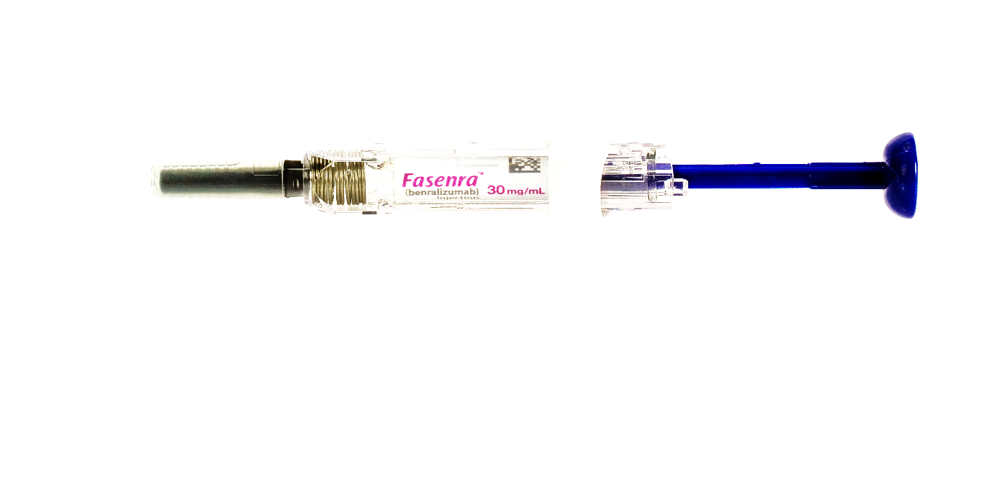
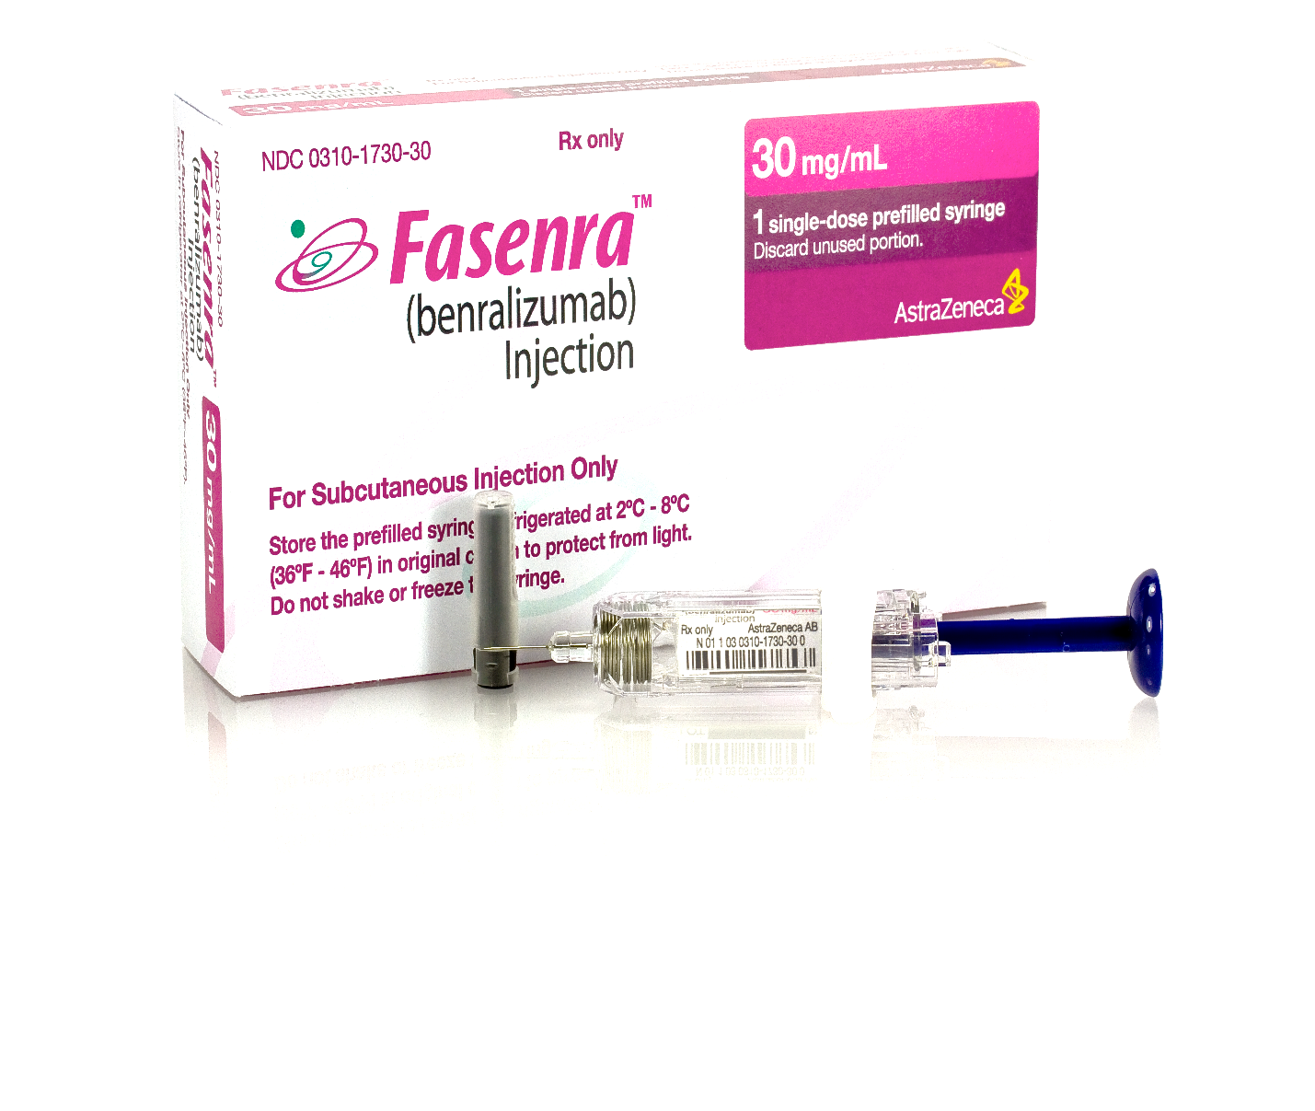
FASENRA Posology and Method of Administration
Posology
The recommended dose of benralizumab is 30 mg by subcutaneous injection every 4 weeks for the first 3 doses, and then every 8 weeks thereafter. If an injection is missed on the planned date, dosing should resume as soon as possible on the indicated regimen; a double dose must not be administered.
Fasenra is intended for long-term treatment. A decision to continue the therapy should be made at least annually based on disease severity, level of exacerbation control, and blood eosinophil counts.
Method of administration
Fasenra is administered as a subcutaneous injection by a healthcare professional.
It should be injected into the upper arm, thighs, or the abdomen. It should not be injected into areas where the skin is tender, bruised, erythematous, or hardened.
Note: FASENRA syringe not shown at actual size.
FASENRA Summary of Product Characteristics.
Notes:
Note
Present slide
Reference
Fasenra Summary of Product Characteristics.

Slide 64
Summary

Slide 65


Summary
Benralizumab is the only humanized, anti-eosinophil, anti-IL-5 receptor alpha monoclonal antibody that induces active EOS apoptosis via antibody-dependent cell-mediated cytoxicity^{1-3,4}
Rapid and near complete depletion of blood EOS counts was observed in patients, with gradual recovery of blood EOS counts after benralizumab discontinuation, irrespective of previous exposure^{4,5}
Benralizumab significantly reduced exacerbations, improved lung function, and reduced OCS dose in patients with severe uncontrolled asthma vs. placebo^{4, 6-8}
74% of patients with blood EOS ≥300 cells/µL at baseline continuing benra Q8W were exacerbation free during the second year of treatment⁴
Patients receiving benralizumab for a second year had safety and tolerability outcomes similar to those receiving benralizumab during the 1st year of treatment, with no new safety signals that might be associated with long-term depletion of EOS⁴
IL-5R = interleukin-5 receptor; NK = natural killer.
1. Molfino NA et al. Clin Exp Allergy. 2011;42:712-737; 2. Tan LD et al. J Asthma Allergy. 2016;9:71-81; 3. Busse WW et al. Eosinophils in Health and Disease. London, UK: Academic Press; 2013: 587-591; 4.Busse WW et al. Article online ahead of print. Lancet Respir Med. 2018; 5. Pham TH et al. Respir Med. 2016;111:21-29; 6. Bleecker ER et al. Lancet. 2016;388:2115-2127; 7. FitzGerald JM et al. Lancet. 2016;388:2128-2141; 8. Nair P et al. N Engl J Med. 2017;376:2448-2458.
Notes:
Note:
Present slide.
Abbreviations:
EOS = eosinophil; OCS = oral corticosteroid; Q8W = every 8 weeks.
References:
Molfino NA et al. Clin Exp Allergy. 2011;42:712-737;
Tan L, Bratt J, Godor D, et al. Benralizumab: a unique IL-5 inhibitor for severe asthma. J Asthma Allergy 2016;9:71-81.
Busse WW, Molfino NA, Kolbeck R. Interleukin-5 receptor-directed strategies. In: Lee JJ, Rosenberg HF,eds. Eosinophils in Health and Disease. London, UK: Academic Press; 2013: 587-591.
Busse WW, Bleecker ER, FitzGerald JM, et al. Long-term safety and efficacy of benralizumab in patients with severe, uncontrolled asthma: 1-year results from the BORA phase 3 extension trial [published online ahead of print November 7, 2018]. Lancet Respir Med. 2018. http://dx.doi.org/10.1016/S2213-2600(18)30406-5. Accessed November 8, 2018.
Pham TH, Damera G, Newbold P, et al. Reductions in eosinophil biomarkers by benralizumab in patients with asthma. Respir Med. 2016;111:21-29.
Bleecker ER, FitzGerald JM, Chanez P, et al. Efficacy and safety of benralizumab for patients with severe asthma uncontrolled with high-dosage inhaled corticosteroids and long-acting β₂-agonists (SIROCCO): a randomised, multicentre, placebo‑controlled phase 3 trial. Lancet. 2016;388:2115-2127.
FitzGerald JM, Bleecker ER, Nair P, et al. Benralizumab, an anti–interleukin-5 receptor α monoclonal antibody, as add-on treatment for patients with severe, uncontrolled, eosinophilic asthma (CALIMA): a randomised, double-blind, placebo-controlled phase 3 trial. Lancet. 2016;388:2128-2141.
Nair P, Wenzel S, Rabe KF, et al. Oral glucocorticoid-sparing effect of benralizumab in severe asthma. N Engl J Med. 2017;376:2448-2458.

